Slide 1
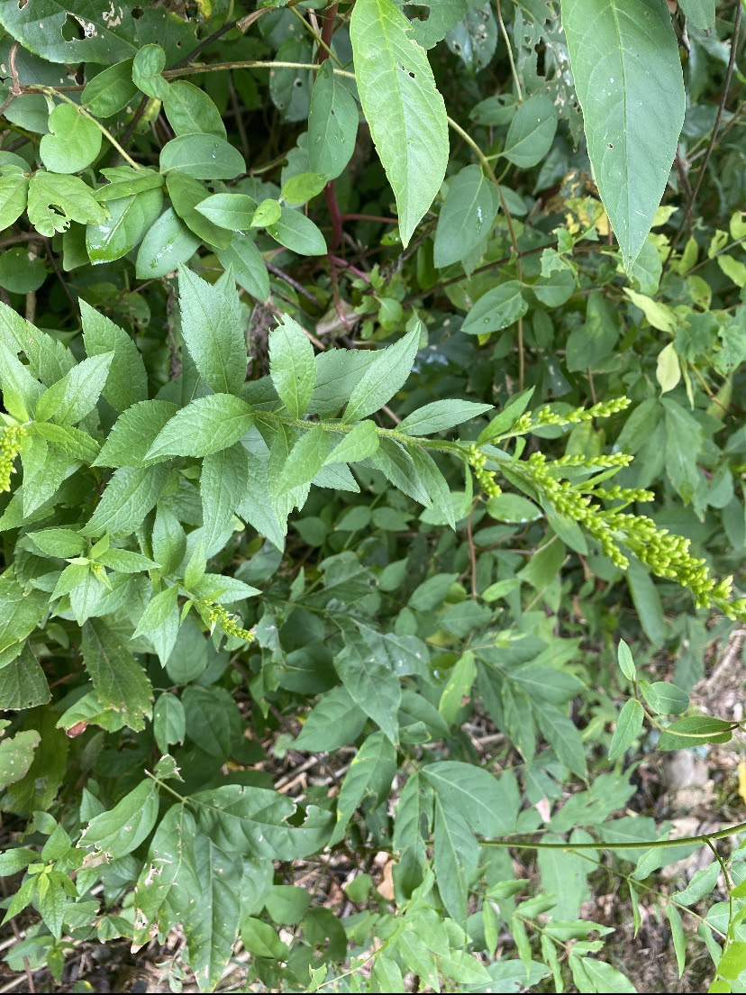
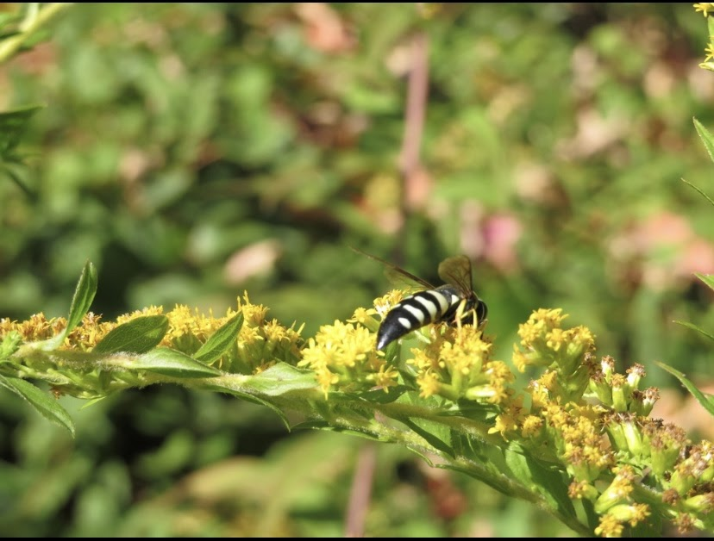
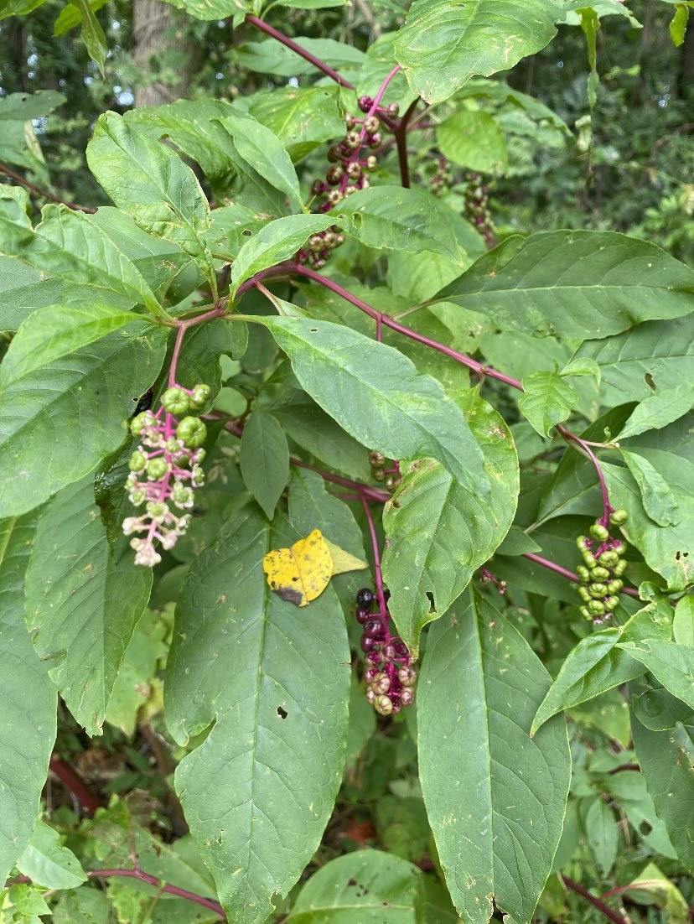
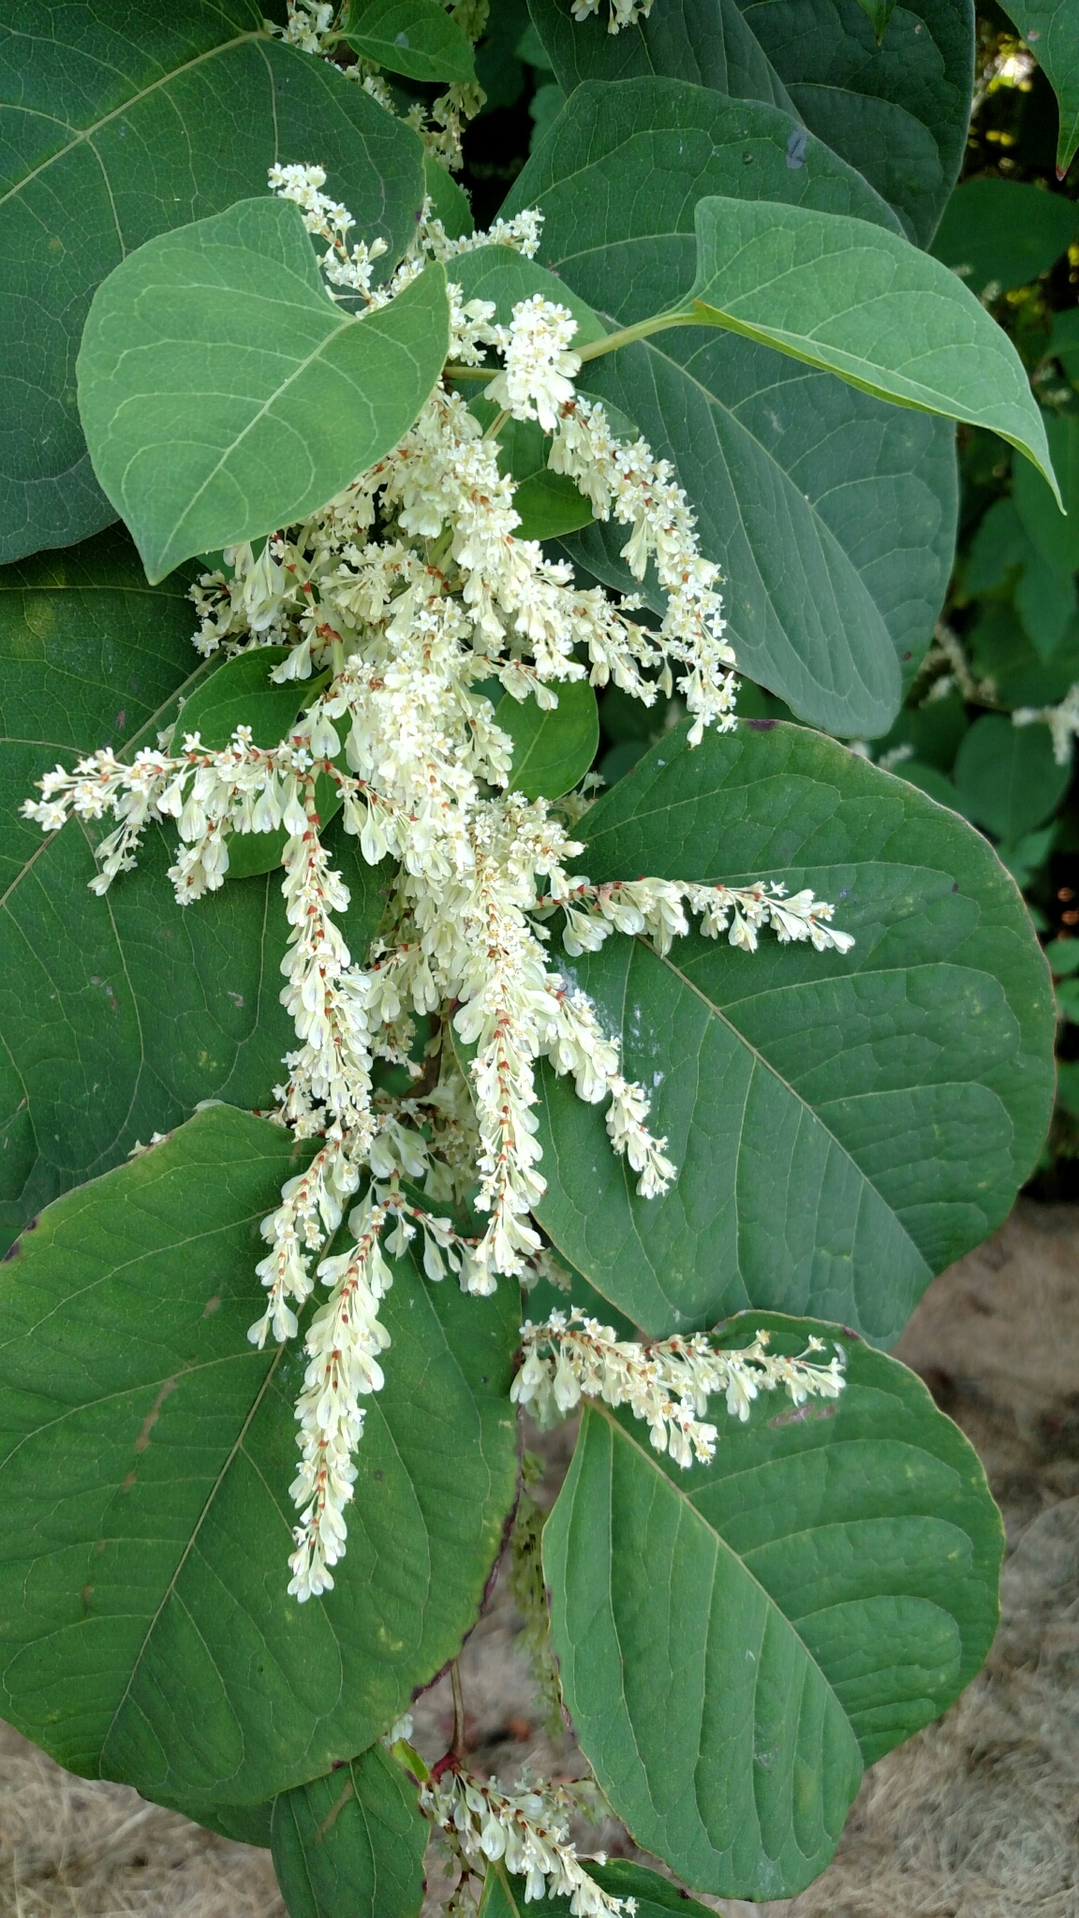
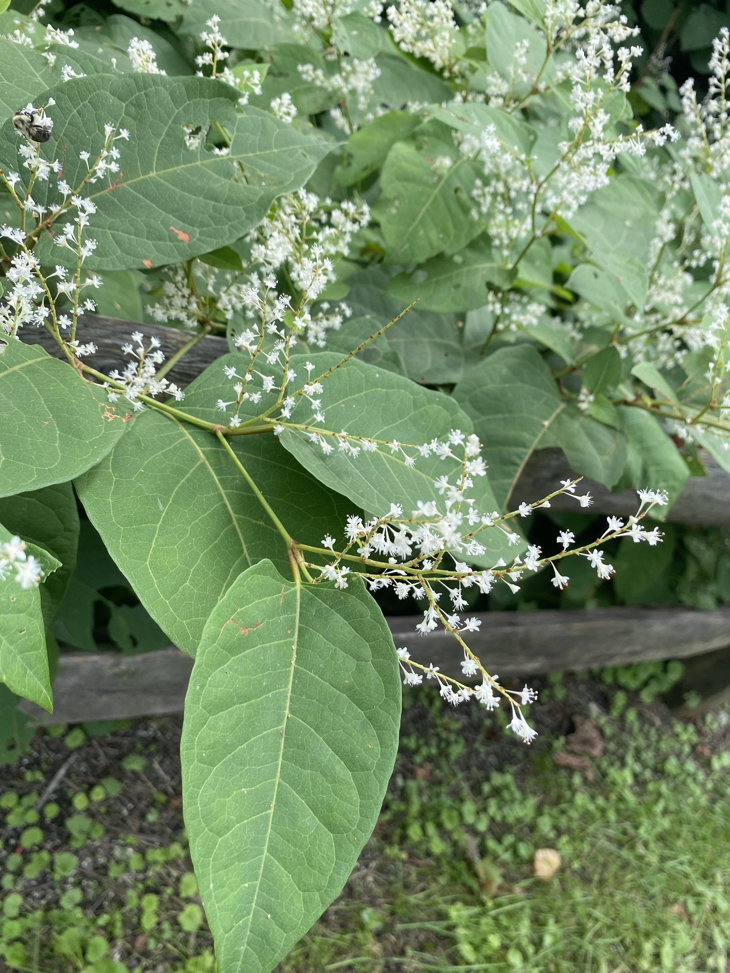
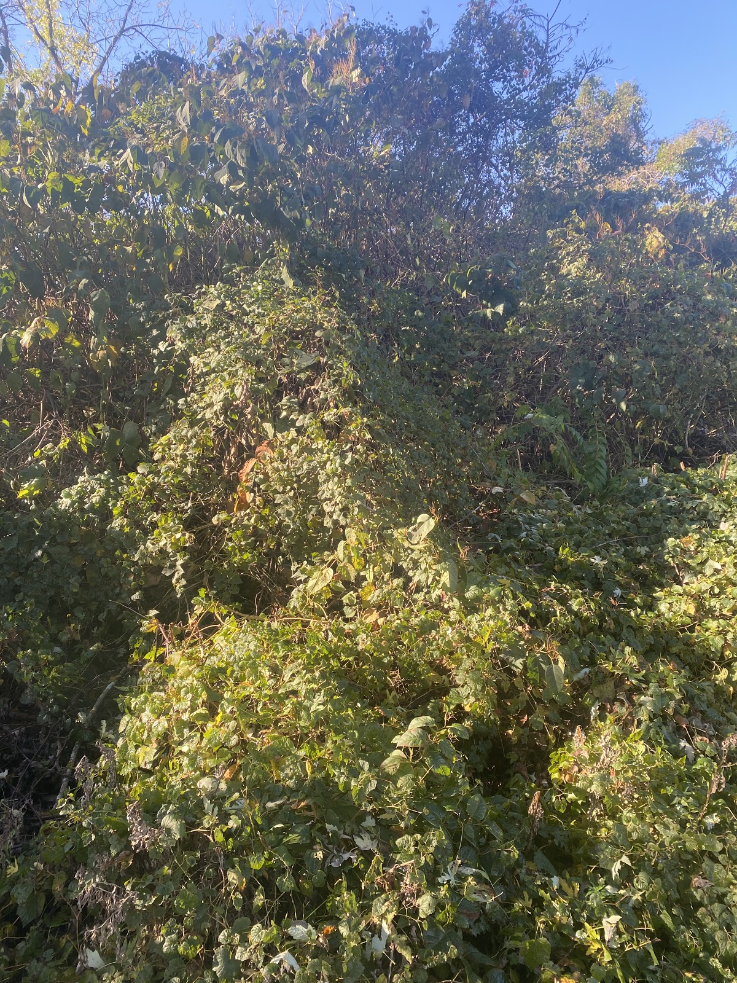
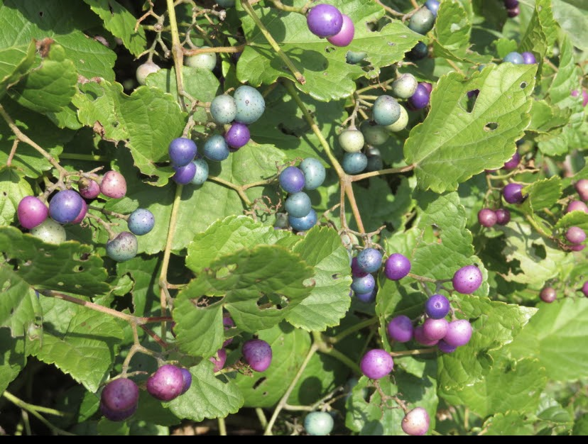
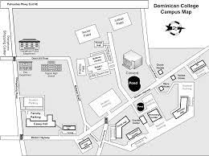
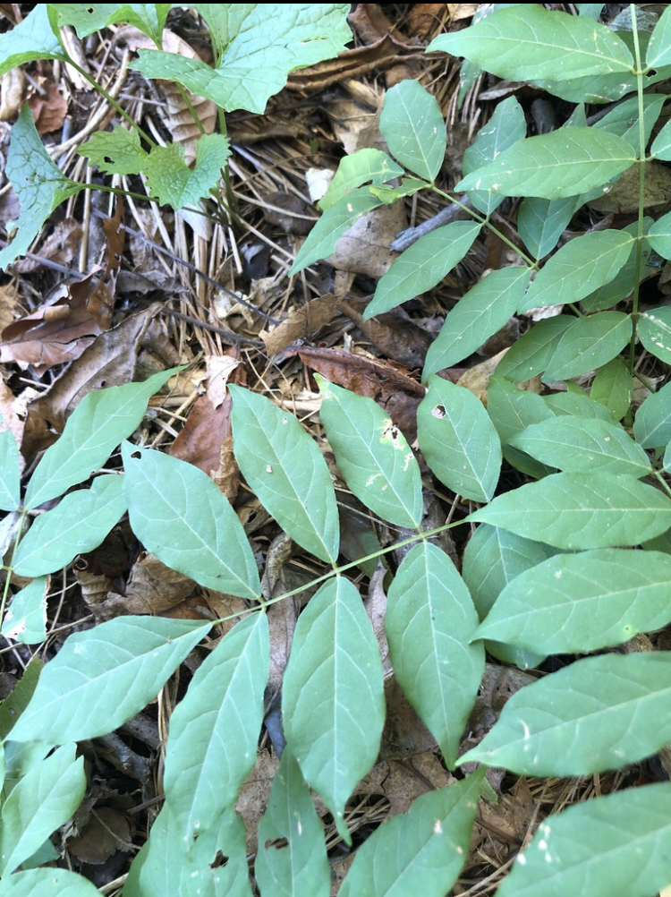
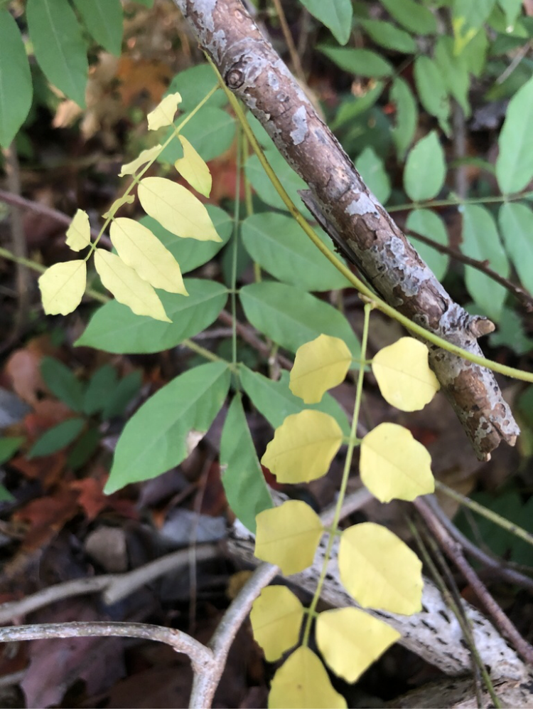
Hennessy Center Biodiversity Project in Orangeburg, New York
Alana Fontanez, Geord Myrthil, Samuel Jean
Dominican College
Advisor: Dr. Regina Alvarez
Background
Abstract
Since times of antiquity numerous plants and animal species were traded and sold, so they began to find their way in countries to which they were not native. Natives are indigenous to an ecosystem and have been there as a result of only natural processes, not human intervention. Native plants are vital for the overall success of ecosystems. They are beneficial to insects and birds and without them many species would suffer. Invasive species are known to invade into native flora and grow uncontrollably. They are a major threat to global agriculture because they destroy and interfere with normal crop production. These species which are invading ecosystems are one reason why certain insect herbivores and bird species are in danger of being compromised. They grow over and replace their native food.
In all ecosystems, biodiversity is essential in the overall productivity and sustainability of all species. Organisms develop complex and essential relationships with the physical environment they are in and with other organisms in that ecological community. Native species are plants or animals that have evolved in places over an extended period of time. Non-native species, on the other hand, have been introduced through anthropogenic means to new environments. Invasive species are a subset of non-natives which have the ability to dominate their new environment to the detriment of native species, thus severely lowering biodiversity. Whether brought in by direct or indirect intervention, their characteristics are to live in a nonsymbiotic or harmful way with the organisms they interact with. At Dominican College located in Orangeburg, NY we studied biodiversity at a particular site near the Hennessy Center. At this site we documented and identified biodiversity by uploading photos to an app called iNaturalist. We were interested in the extent of native and non-native plants, with a special interest in the invasive species. Observations and potentially new species were documented weekly or biweekly as we revisited the site in small groups or individually, making sure to keep careful record of documented species. It was clear that over the course of many years the biodiversity of the area had become severely impacted by the introduction of several non-native and invasive species. Wooded landscapes similar to our study site are potentially good habitats for wildlife to visit and thrive in. However, without proper maintenance, they succumb to the effects of invasive plants. Most of these plant species are common and are found throughout Rockland County and New York State. Over the course of many years the biodiversity of Rockland County and New York State has become impacted by the introduction of several non-native, invasive species. Our research highlighted three species of invasives - Wisteria sinensis a native plant from Guangxi and Guizhou, two Chinese provinces; Ampelopsis glandulosa, an ornamental plant that is native to China; Reynoutria cuspidatum, a plant that is native to Eastern Asia (Japan, Taiwan, China). Our research indicates that removal of invasives and planting and encouragement of natives, even in small and medium sized landscapes, greatly improves habitat and increases biodiversity. This has become very important for several environments to ensure the protection of native species, birds, humans, and insects.
Objectives:
Document all species at the project site.
Determine how many invasives species are present and document the extent of the invasion.
Observe any interactions between birds or insects and plant species.
Determine how many natives are located at the site.
Figure 4. Solidago altissima, Tall goldenrod. A native American plant belonging to the Asteraceae (Sunflower family). It is often found in savannahs or prairies and is proven useful to ease inflammation in the body.
Observations
1B
1C
1A
1B
Figure 5 . Celtis occidentalis is a tree native to North America. It is non-invasive and belongs to the Cannabaceae (Hemp family). It is often identified by the irregular ridges on the bark. It is a deciduous tree with a grayish-brown color. It can grow up to 70 feet and its leaves range in color from yellow to green.
PROCEDURE
Visit the site on Campus
Weekly/Bi-weekly check-ins to view new species
Use iNaturalist to document species
Add to shared Biodiversity document
2A
2A
Figure 6. Reynoutria
cuspidatum is an invasive species known to rapidly proliferate and create monocultures, leaving soil prone to erosion if not controlled. It is in the Polygonaceae (Buckwheat family. This resilient plant can cause harm to local native plant and animal species by crowding local vegetation and using up nutrients and water. As an herbaceous perennial plant, its ability to go dormant in the winter and return in the spring makes it extremely difficult to control​.
Figure 1A. Bicyrtes quadrifasciatus, Sand wasp. Commonly found in North America. Figure 1B. Phytolacca americana, American pokeweed. Figure 1C. Typical Orbweavers (Family Araneidae).
Upload photos & determine If species are native, non-native, and invasive
2B
Ampelopsis glandulosa, Porcelain Berry, Vitaceae (Grape family). This is a non-native invasive plant. It is an ornamental plant native to China, Japan, India, and Nepal. Figure 2a This stand of A. glandulosa has covered and killed several trees and shrubs in this area. Figure 2b Berries that range in color from purple to blue with a red stem. The berries are eaten by birds and seeds are dispersed over very large geographic areas.
Work Site
Figure 3. Wisteria sinensis is an invasive species. The species originated from China. Chinese Wisteria is a woody, deciduous, perennial climbing vine. It is in the Fabaceae (Legume family). Chinese Wisteria spreads by seed and in riparian areas, can be transported by water. It can reproduce vegetatively by producing stolons (above-ground stems) that produce shoots and roots at short intervals.
Summary and conclusions
Native plant areas are known to attract more species of birds to find their food rather then landscaped areas. Monitoring of the site will help to control the overgrowing of invasives onto non-invasive native plants. From our site we found 52 species in total; 31 natives, 14 non-natives, 8 invasives, and 7 unknown. The result of the invasives include reducing agricultural production, harming human health, reduced access to land, and altered plant community structure. Studies have shown that invasives can be very costly, especially with regard to agricultural. Landowners have attempted mechanical control methods, chemical control, and fencing to reduce the impact of invasives. With decreased amounts of livestock and crops, ideas such as controlled grazing have become very effective instead of use of herbicides.It was noticed that it was more cost effective, reduced weed competition, controlled invasives, and restored wildlife habitat.
References:
CWeston, Leslie & Barney, Jacob & Ditommaso, Antonio. (2005). A Review of the Biology and Ecology of Three Invasive Perennials in New York State: Japanese Knotweed ( Polygonum cuspidatum ), Mugwort ( Artemisia vulgaris ) and Pale Swallowwort ( Vincetoxicum rossicum ). Plant and Soil - PLANT SOIL. 277. 53-69. 10.1007/s11104-005-3102-x.
ReMartinson, Richard. "Native plants in urban landscapes: a biological imperative." Native Plants Journal, vol. 21 no. 3, 2020, p. 275-280. Project MUSE muse.jhu.edu/article/776509
Paini, Dean R., et al. “Global Threat to Agriculture from Invasive Species.” PNAS, National Academy of Sciences, 5 July 2016, www.pnas.org/content/113/27/7575.
Burghardt, Karin T et al. “Impact of native plants on bird and butterfly biodiversity in suburban landscapes.” Conservation biology : the journal of the Society for Conservation Biology vol. 23,1 (2009): 219-24. doi:10.1111/j.1523-1739.2008.01076.x
Shackleton, Ross T., et al. “The Role of Invasive Alien Species in Shaping Local Livelihoods and Human Well-Being: A Review.” Journal of Environmental Management, Academic Press, 23 July 2018, www.sciencedirect.com/science/article/pii/S0301479718305267.
“Conservation Grazing for Land Stewardship.” Conservation Grazing for Land Stewardship - NYS Dept. of Environmental Conservation, www.dec.ny.gov/lands/86641.html.
Dominican College Orangeburg, NY 10962

