Slide 1
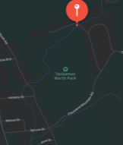
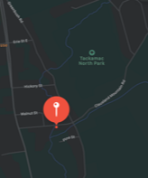
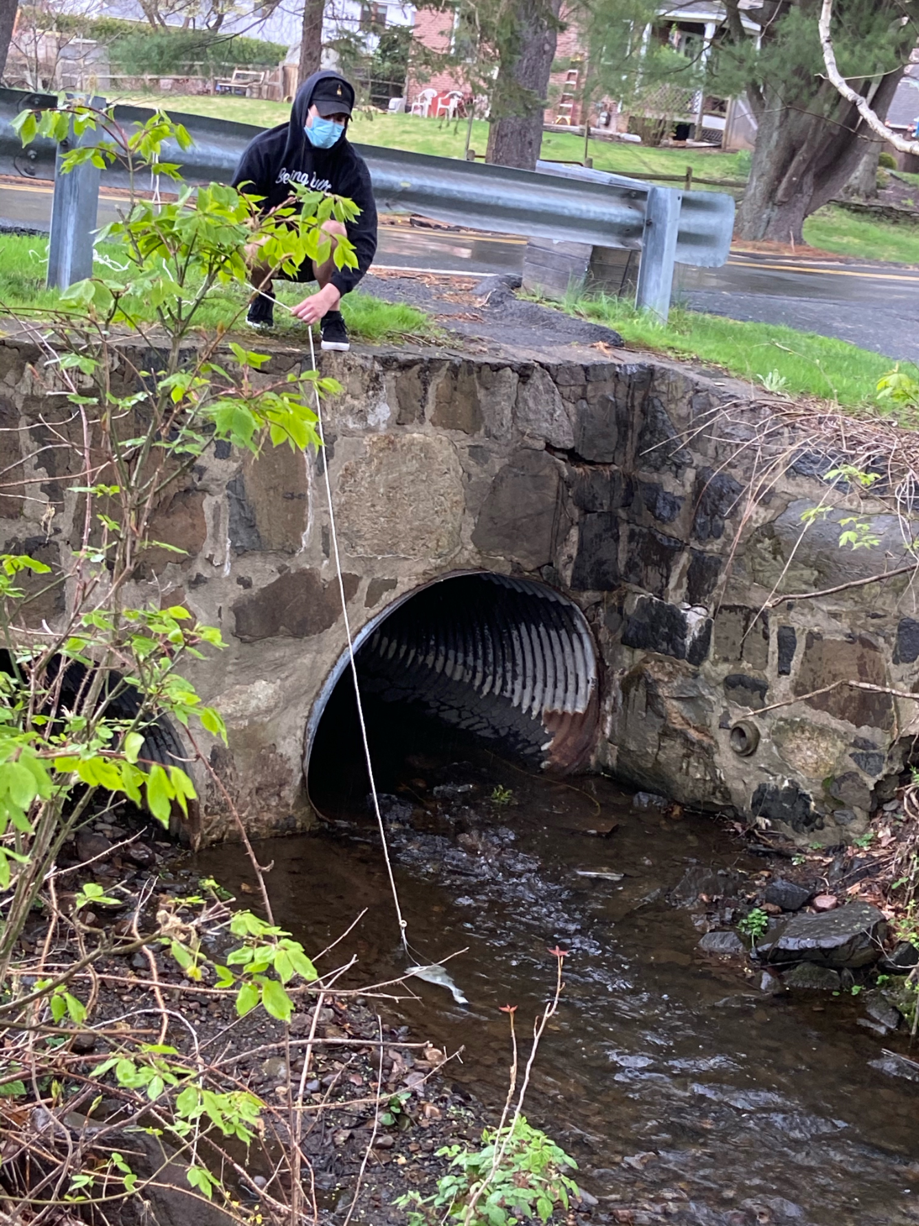
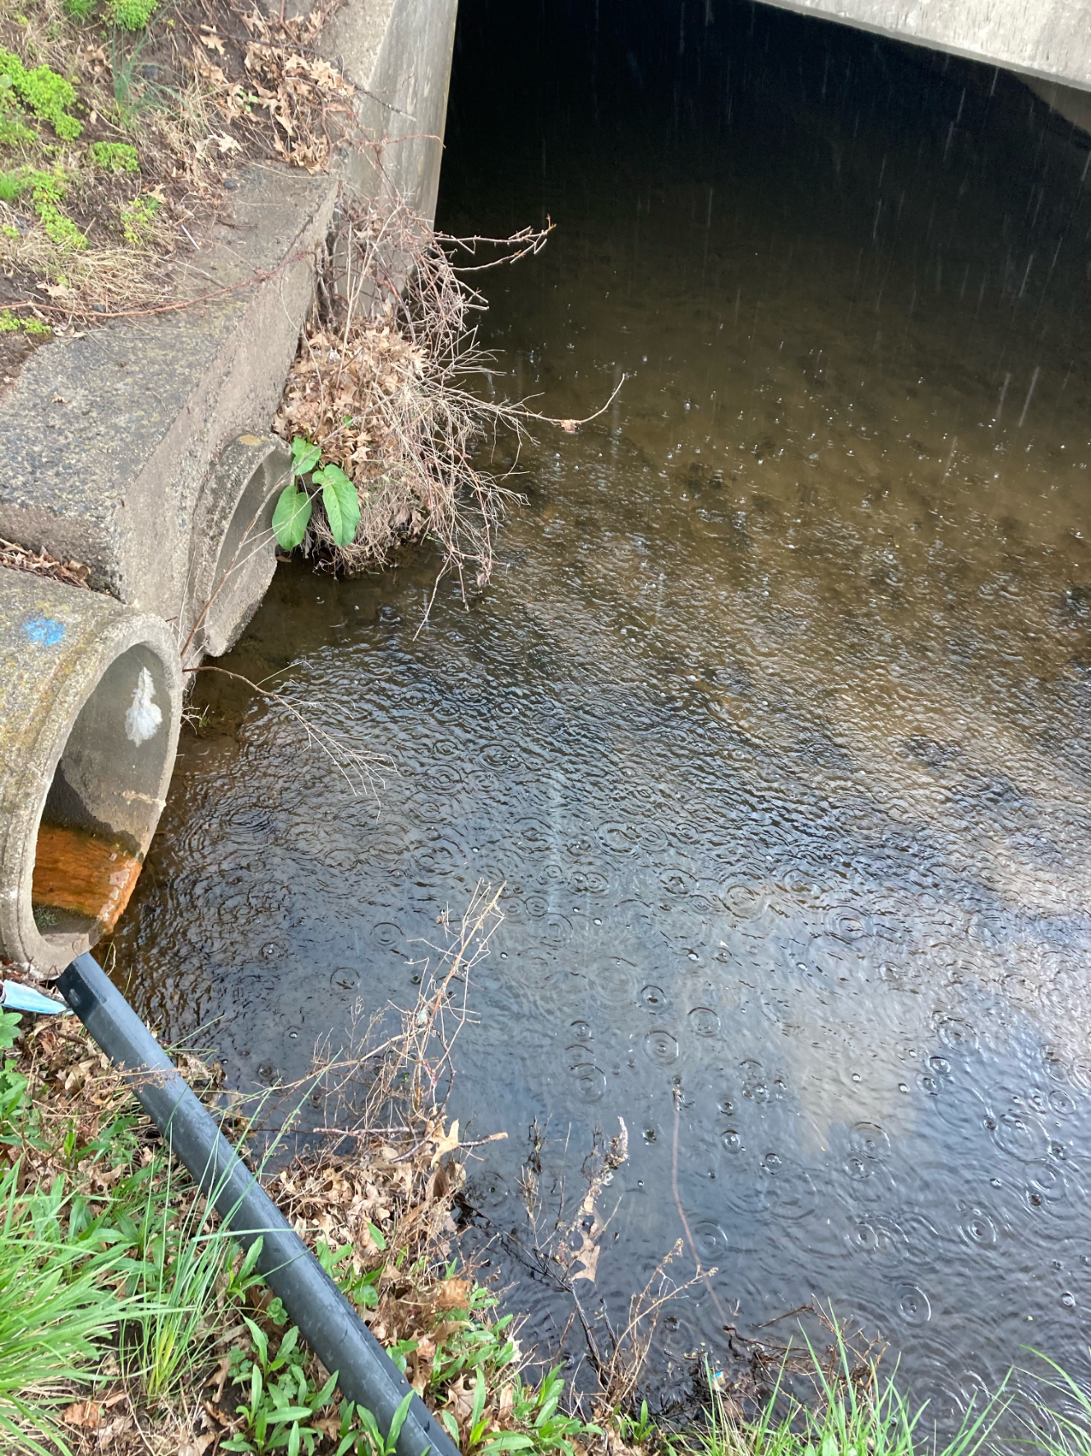
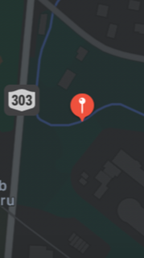
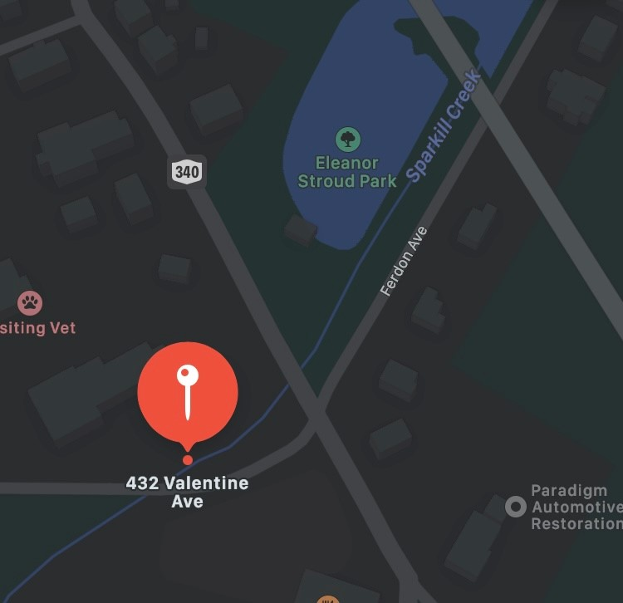
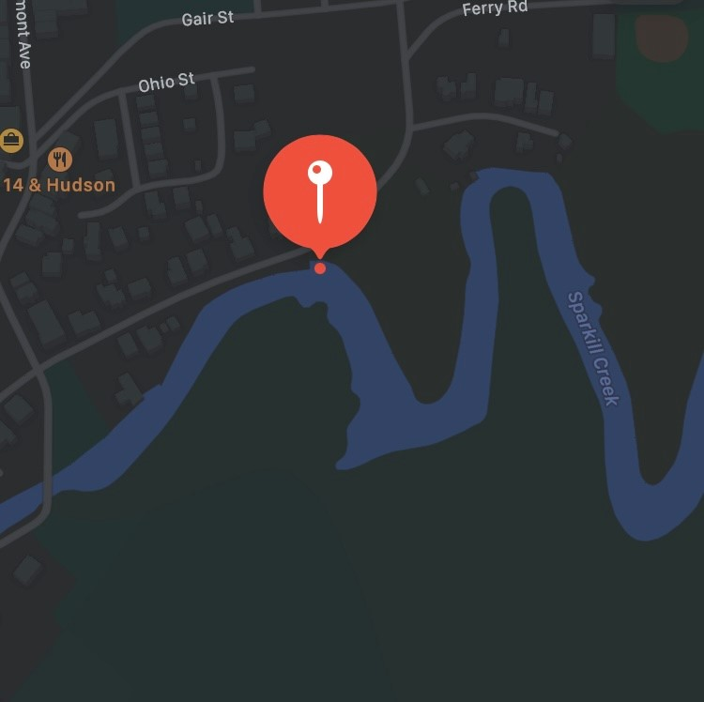
Hydrobiological Indicators of Pollution in the Sparkill Creek of Blauvelt
Luke Friedman and Louis Levine, Dominican College
Advisor Dr. Regina Alvarez
Background
Abstract
Harmful algae blooms are categorized as a group of organisms which bloom in the presence of excess phosphorus, nitrogen, and carbon, these nutrients can sometimes come from agricultural runoff and unmaintained sewer lines but also many other sources as well. Agricultural runoff comes from sources such as lawns and farmlands that flow downriver and build up at a rate that oversaturate the algae with excess nutrients that exist normally in the environment. As a result, the affect the stability of aquatic environments mainly by depleting the volume of oxygen in the water which other organisms depend on.
Organizations like the Sparkill Creek Watershed Alliance in Sparkill, New York have tested Sparkill Creek for the fecal indicator bacteria Enterococcus over the course of a 5-year span up to 2016. Over this period, it was discovered that greater than 90% of Sparkill Creek samples failed under both conditions tested pre- and post-rainfall, while it also measured in at just under an alarming twenty-five times the suggested EPA threshold deemed safe for swimming. (Sparkill Creek Watershed Alliance)
This is important because Sparkill Creek is a tributary to the Hudson River where thousands of people swim and participate in water sports every year. These blooms are a problem for the health of the Sparkill Creek ecosystem, as well as the health of the people who live on the creek, many of which has small person farms that directly border the creek. We must monitor these levels because Harmful Algae Blooms or HABS as they are often referred to have taken a great toll on the overall health of the rivers, lakes, and other neighboring water bodies.
Globally, there are many environmental crises that have been growing over the past decades, most of which affect our daily lives. One of the biggest problems that we are facing worldwide is pollution. A large source of pollution is chemicals going into our environment, often without our knowledge. There are indicators in the environment that can help us determine where pollution is present and may help in determining the source. One of them is microalgae. The term algae is used to define a large and diverse group of photosynthetic eukaryotic organisms. Our research was focused on identifying microalgae in various points of the Sparkill Creek, which is a tributary of the Hudson River. Microalgae proliferate when exposed to large amount of nutrients such as phosphorus and nitrogen. Excessive amounts of these nutrients can lead to serious problems in the environment. Finding these bioindicators allows us to determine what the problem is and take steps in finding a solution Our research consisted of collecting samples from Sparkill Creek for testing. Some of these samples were collected using a plankton-tow and others were collected from the sediment. Getting samples of both the flowing water and the sediment underneath is vital since microalgae can live both in the sediment in the creek as well as in flowing water. After collecting these samples, they were filtered and placed on depression slides to be viewed under a microscope. Using identification keys and internet searches we identified microalgae and other microorganisms to the lowest taxonomic level possible. Several of the species of microalgae we have identified are Bacillaria paxillifer, Nitzschia, Melosira varians, Navicula, Fragilaria crotonensis, Spirogyra, several desmids, and a few others. Once we identify the algae present in different locations of the watershed, we consult our references to determine if any are indicators of pollution. By researching the algae and the plants in the surrounding area, we can determine what the impact is on the environment and on us.
Observations
Aims and Goals:
This project focuses on testing the water in Sparkill Creek and trying to pinpoint where the highest concentration of nutrients are to determine if there are conditions different from other places on the creek. Different types of algae will correlate to an increase in specific nutrients, which will help us determine what type of pollution is in the creek.
Our main goal is to see if there is a pattern of change along the creek that we can map out and see if the higher nutrient areas are affecting the surrounding area.
SITE SELECTION
Figure 1:
Fragilaria crotonensis is considered a marker that the levels of reactive nitrogen have increased above the threshold in oliogotropic lakes of the western United States where diatom assemblages become more like assemblages in mesotrophic and eutrophic lakes.
Figure 2:
Melosira varians is very common in rivers and lakes across North America. This species is considered to be tolerant of poor water quality, although it may occur in more pristine sites as well. This diatom is primarily found in benthic habitats, with cells joined in long filamentous chains.
Figure 3:
Navicula is a genus that has over 80 different species in it so it is hard to pinpoint the exact species that we have found. We found 6 different Navicula in the pictures that we took and here are three different ones in one picture that we found.
Figure 4:
Bacillaria paxillifer is a diatom that can tolerate fluctuations in salinity. Consequently, Bacillaria is found rivers with higher salt content, as the result of human influence or of influx of marine waters. In freshwaters, it is considered to be indicative of human induced pollution. The movement occurs by the raphe system, as each cell slides across the neighboring cell. Bacillaria grows in colonies in benthic, epipelic or planktonic habitats, from freshwater to brackish waters.
Tackamac North Park,
Orangeburg, NY 10962
Spruce Street, Orangeburg,
NY 10962
The intersection of Mountainview Ave
And Route 303 Orangeburg, NY 10962
Rockland County Sewer Plant
- 4 NY–340, Tappan, NY 10983
93 Paradise Ave
Piermont, NY 10968
432 Valentine Ave Sparkill, NY 10976
PROCEDURE
Location of sampling: First we looked at the map and tried to find the closest point we could go to get to the start of the creek. Once we had a starting point, we continued down the creek in short segments to see if the conditions were different as we moved down the creek. Since the creek is very long, we traveled down to four points on the creek that were close to Dominican College and then went as far down as we could to the end of the creek right before it flows into the Hudson and tested there.
Filtering: To further concentrate the samples my partner and I vacuum filtered the samples by connecting a Büchner funnel to the top of a vacuum flask, then connecting one end of a vacuum hose to the flask and the other end to the faucet of the sink. Turning on the faucet created a suction in the flask and the funnel. By placing filter paper on top of the perforated plate in the funnel, and allowing the suction to secure the paper, we could then pour our water samples into the funnel, which filtered the water into the bottom of the flask and left any remaining particles on the filter paper. This filtering process was performed for each sample, using a clean sheet of filter paper per sample. Each paper was then placed into its own petri dish, and approximately 10 mL of the water filtered out from that sample was poured on top of the filter paper, so that we might easily draw from these samples to create wet mounts.
Figure 5:
Nitzschia is a relatively large genus that contain hundreds of freshwater and marine species. Nitzschia contains many pollution-tolerant species that have been used as indicators of deteriorated water quality.
Figure 6:
Actinophryid, (a Heliozoan, not an alga), under unfavorable conditions, will form a cyst, which is multi-walled and covered in spikes. While enclosed it may undergo a peculiar process of autogamy or self-fertilization, where it goes through meiosis and divides to form two gametes, which then fuse together again. From our samples we were not able to find one with a cyst that we could see. This suggests that favorable conditions were met.
Figure 7:
Luke Friedman is pictured collecting a sample from the Spruce Street collection location using a plankton tow. A sediment sample was also collected from after this, just as with every location.
Figure 8:
Pictured above is the Mountainview Ave and Route 303 intersection collection site. This site contained a large amount of algae, and it is believed that the cause of this is the orange sludge being expelled from the pipe as shown above.
Summary and Conclusions
Collection of samples: At each location we collected water samples using pint-sized containers and large sediment jars. We collected a sample of running water from the creek, a sample of sediment mixed with water, and a sample of water using a plankton tow, which concentrates the number of algae that ended up in the container. We did this by connecting a container to the plankton tow, submerged it under water and let the creek filter into the tow for 10 to 15 minutes before taking the set up out of the water. The samples were put into a refrigerator at roughly 40°F, until they could be observed.
From the samples that we collected from Sparkill Creek our data supports that there are contaminants in the creek that are increasing as you move downstream. Observation of the samples we took from Spruce Street and the Rockland County Sewer plant showed much less concentration of algae than the intersection of MountainView and Route 303. From our data it suggests there could be a change in environment or another unseen condition. We have positively identified the follwing species and genera, Bacillaria Paxillifer, Spirogyra, Navicula, Nitzschia, several Desmids, Melosira varians, and Fragilaria. There are also other organisms present in our samples and we are working to continue to identify them. An outstanding question that we have is where is the pipe at the intersection of MountainView Ave and Route 303 coming from and what is the unknown orange substance dumping into the water. There were also high levels of microplastics in many of the samples. Microplastics smaller than 5mm are of special concern because they can be ingested throughout the food web more readily than larger particles. The origin and cbiochemical makeup of the orange sludge, as well as the high amounts of microplastics found are two topics that should be covered in future investigations.
Microscope and identification: The concentrated samples were observed on wet mounts under the microscope. The photographs were mainly taken at 10x and 40x magnifications. After the photos were taken, we used identification keys and internet searches to identified the microalgae and other microorganisms to the lowest taxonomic level possible.
References:
Jafari, N.G. and Gunale Y.R. 2006. Hydrobiological study of algae of an urban freshwater river, J. Appl. Sci. Environ. Mgt., 10(2): 153-158.
Jahn, R. and Schmid, A. (2007) Revision of the brackish-freshwater diatom genus Bacillaria Gmelin (Bacillariophyta) with the description of a new variety and two new species European Journal of Phycology 42(3): 295-312
Lowe, Rex L. In Aquatic Ecology, Freshwater Algae of North America, Academic Press, 2003, Pages 669-684, ISBN 9780127415505, https://doi.org/10.1016/B978-012741550-5/50020-9.
Patterson, David J and Hausmann, Klaus. "Morulate Bodies in Actinophryid Heliozoa: A Fixation Artefact Derived from Microtubules?" Japan Society for Cell Biology cell structure and function 7, 341-348 (1982)
Saros, J.E., Michel, T.J., Interlandi, S.J. and Wolfe, A.P. (2005) Resource requirements of Asterionella formosa and Fragilaria crotonensis in oligotrophic alpine lakes: implications for recent phytoplankton community reorganizations Canadian Journal of Fisheries and Aquatic Sciences 62: 1681-1681
Sparkill Creek Watershed Alliance - http://www.sparkillcreek.org/
Spaulding, S.A., Otu, M., Wolfe, A.P. and Baron, J. (2015) Paleolimnological records of nitrogen deposition in shallow, high-elevation lakes of Grand Teton National Park, Wyoming, U.S.A. Arctic, Alpine and Antarctic Research 47(4): 701-715.
Whitton, Brian & Rott, E.. (1991). Use of Algae for Monitoring Rivers I. Proc. II International Symposium.
Whitton, B. A. & E. Rott (eds), 1996. Use of Algae for Monitoring Rivers II

