Slide 1
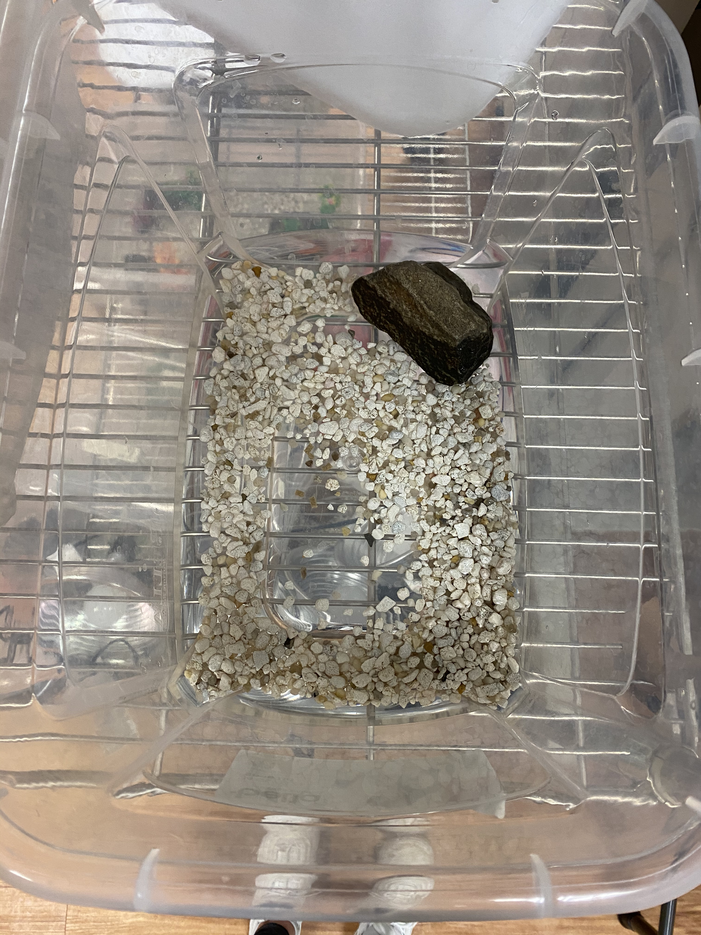
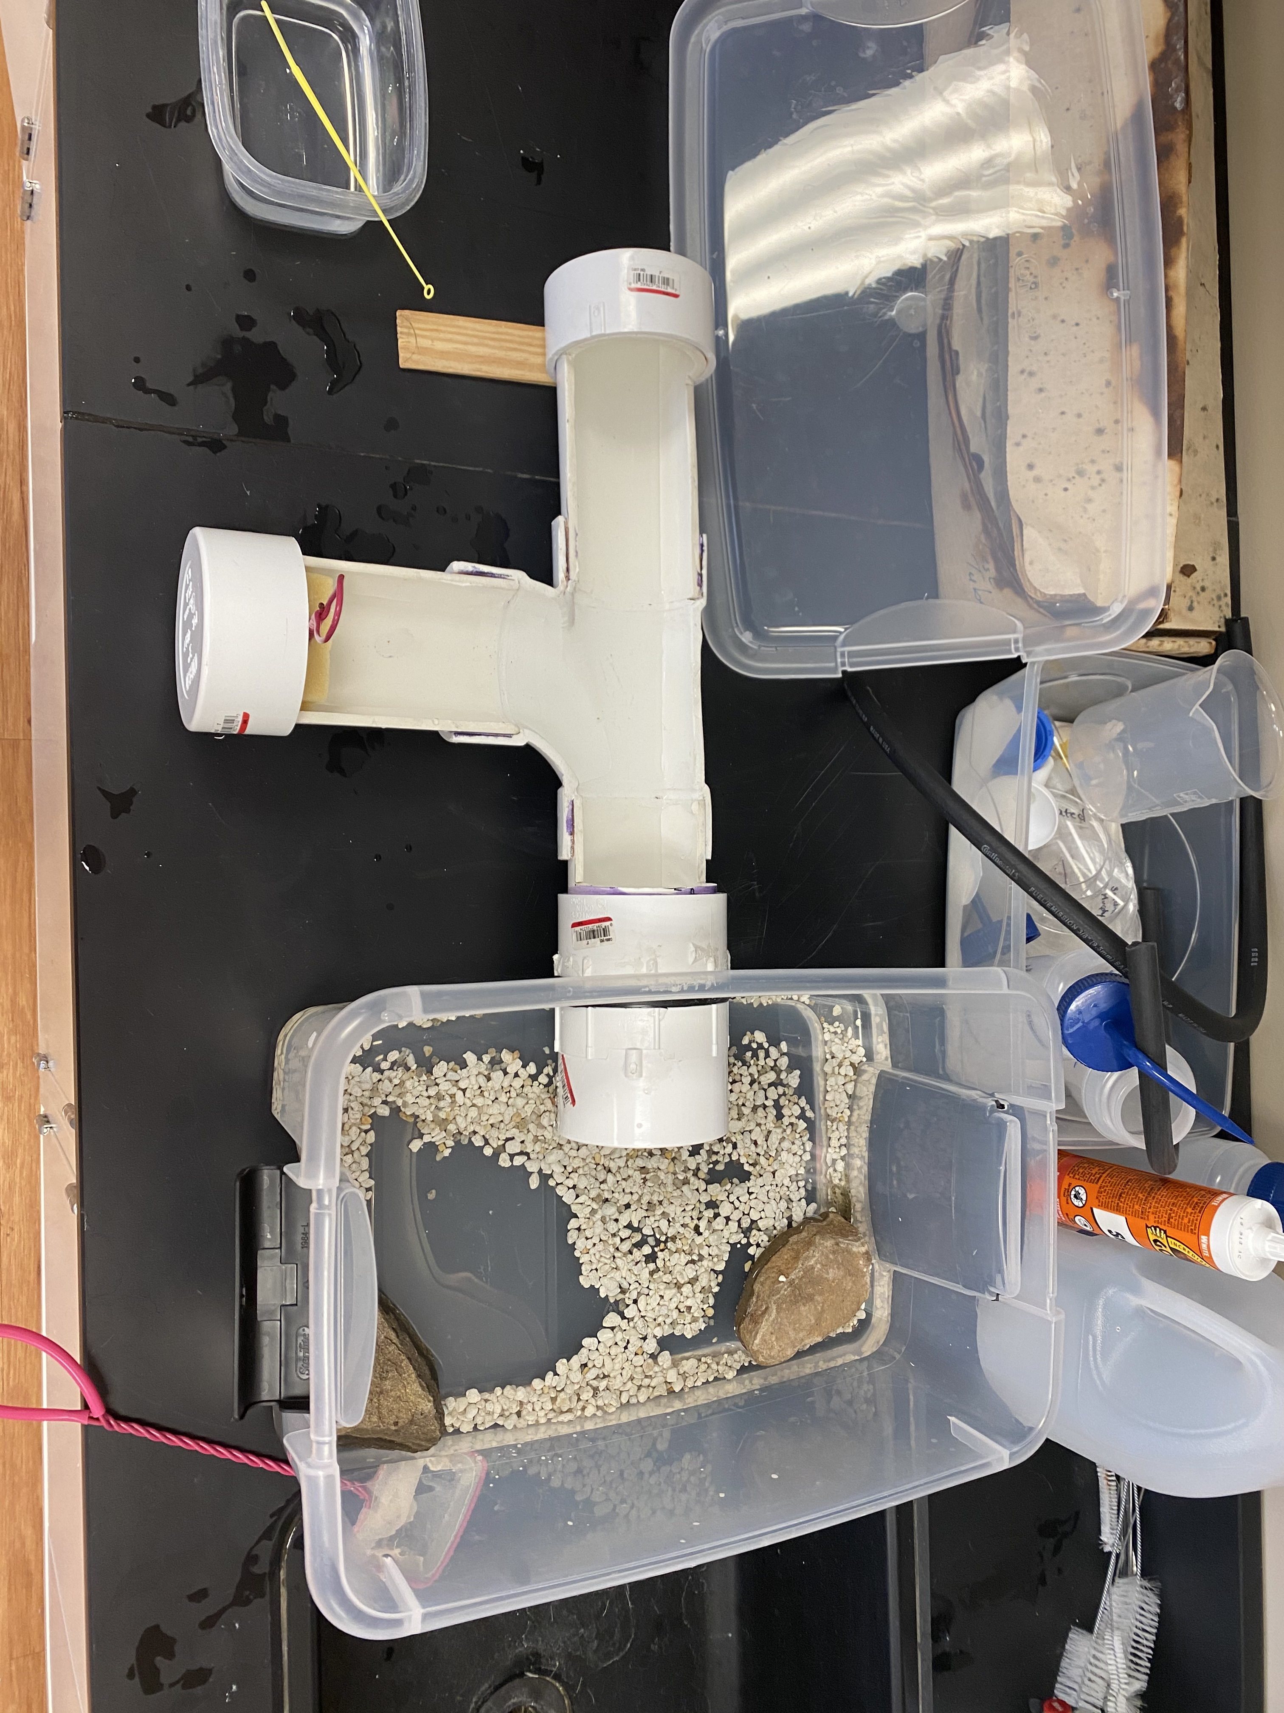
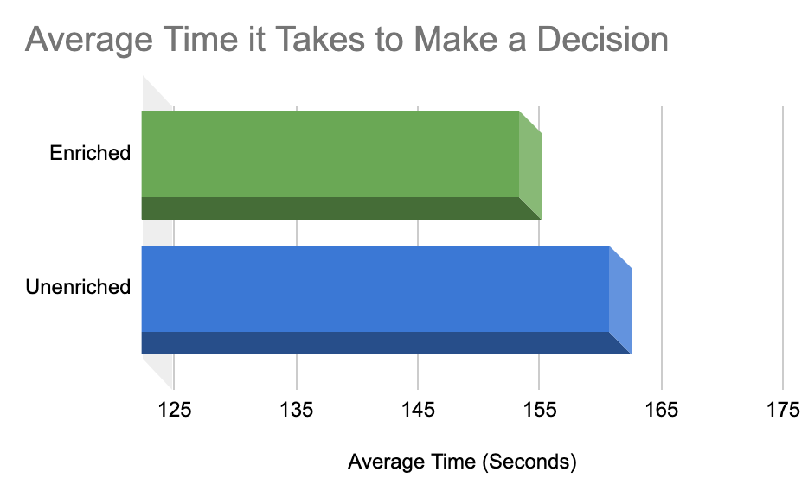
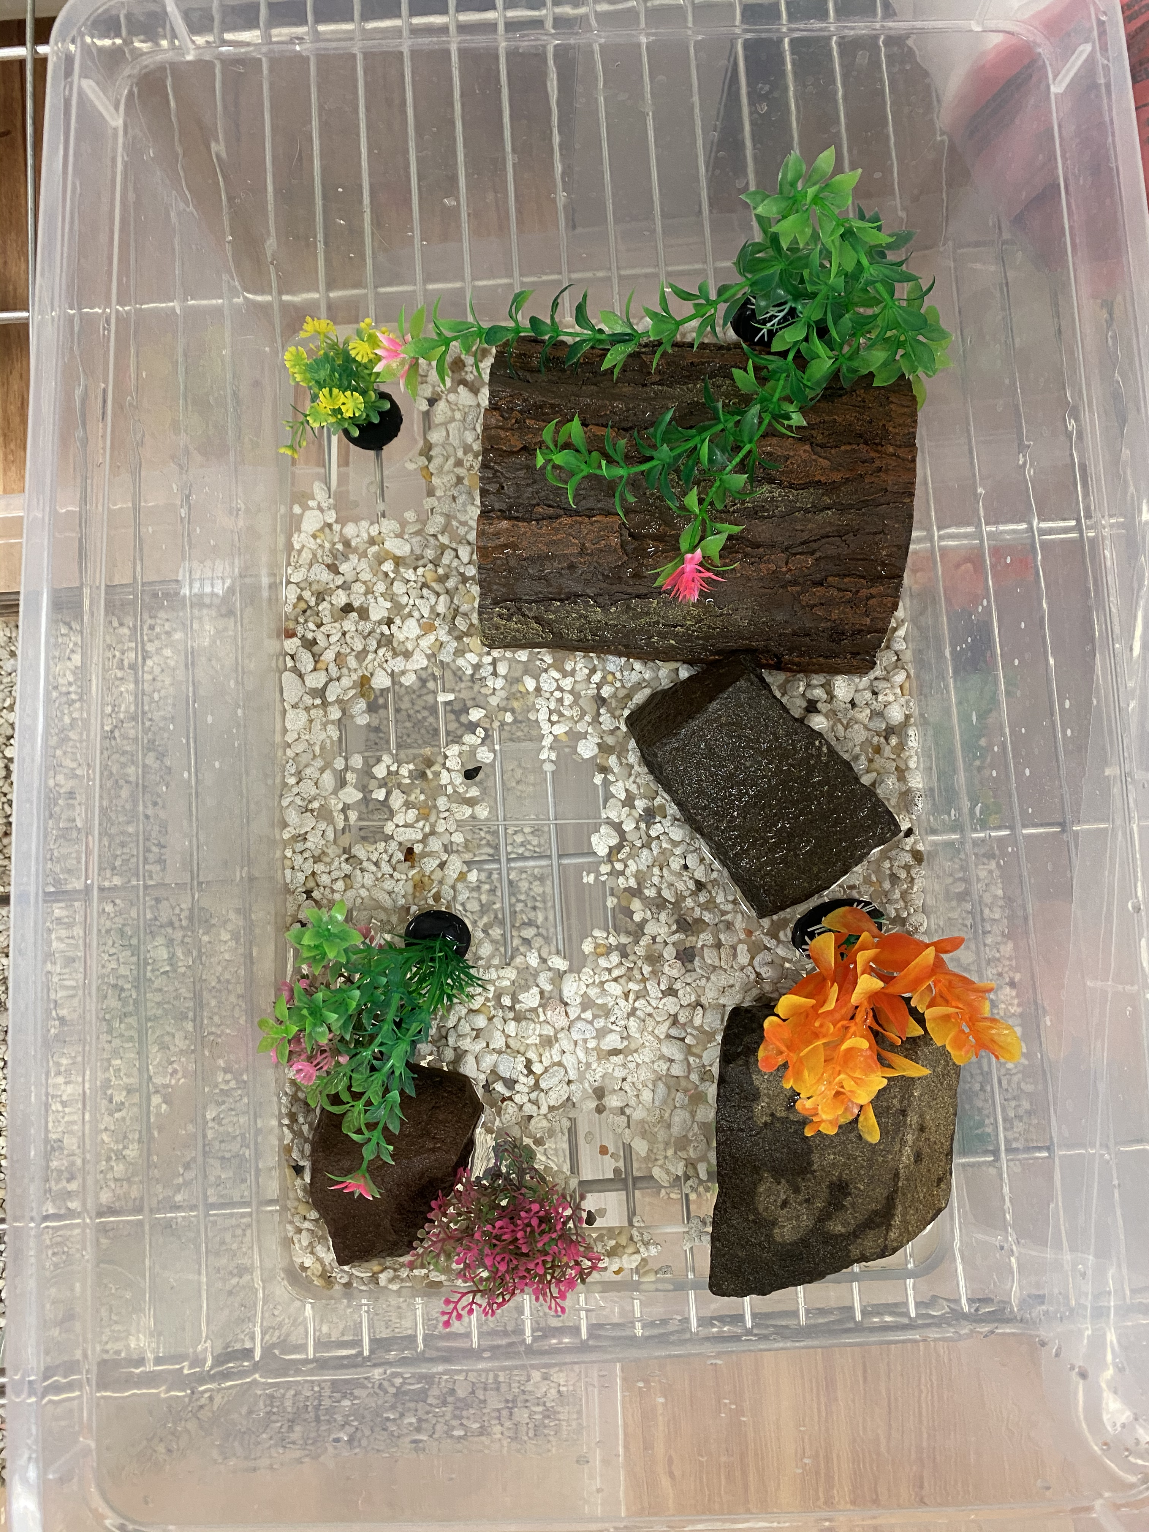
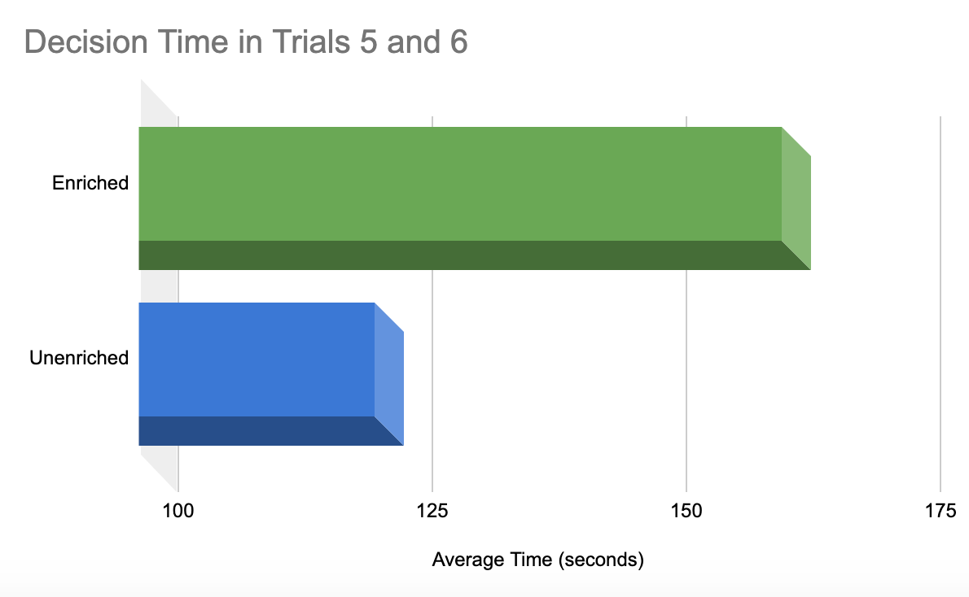
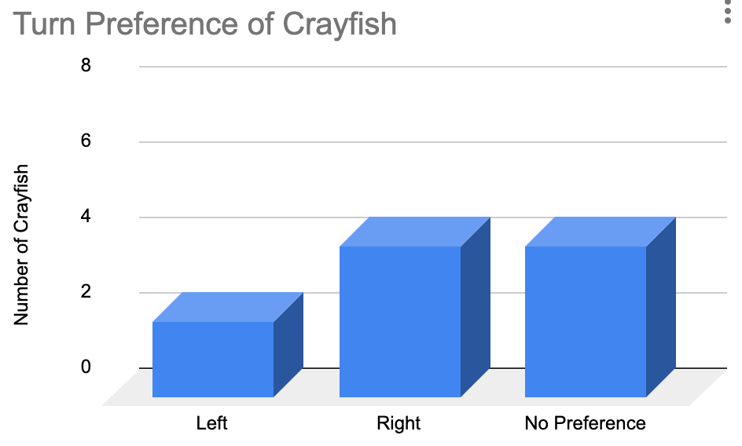
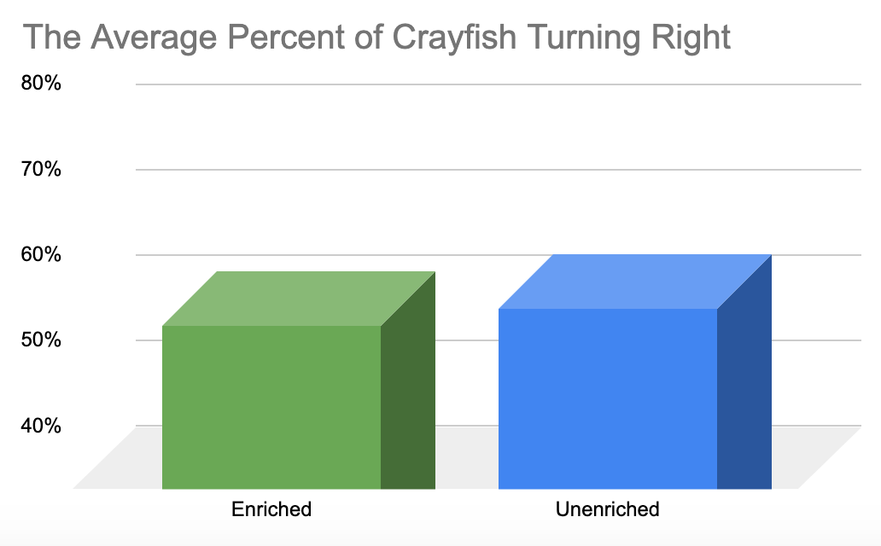
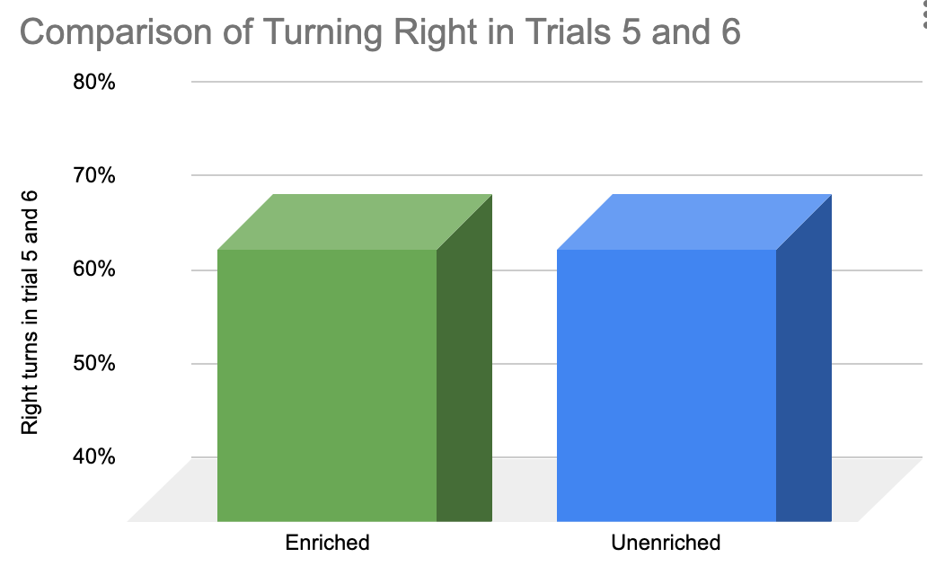
Impact of Environmental Enrichment on Learning in Crayfish
Jenna Vogelsang, Dr. Emma Sarro
Biology Department, Dominican College
Orangeburg, NY, 10961
Jenna.Vogelsang1@dc.edu
Rationale
Environmental setup and behavioral apparatus
Is the response time impacted by enrichment?
It has been believed that environmental enrichment and deprivation plays a key role in learning and memory throughout the nervous system. Social and sensory environmental deprivation can cause impairments of sensory, cognitive and motor functions meanwhile, enrichment can improve these three categories (Wang, 2018). In this experiment, we utilized crayfish (P. fallax f. virginalis) in two environments and a T-maze to determine if there is a significant difference in the choices and time it takes for a crayfish to make decisions. The simplicity of the crayfish’s nervous system and their social nature makes them an adequate candidate for enrichment studies.
Their learning and short-term memory was tested in a T-shaped water maze which allowed them to escape into a holding tank if they turned one of two directions. The experiment examined whether a period of environmental enrichment impacted the ability to demonstrate learning and short-term memory, and also whether it changes as they move from an enriched environment to an unenriched environment and vice versa. Enrichment studies are important to today’s medical field because it is an alternative way to improve the quality of life for aging people as well as people with Huntington's and Parkinson’s disease (Dause, Kirby 2018).
All Trials
Figure 6: The average time it took for a crayfish to make a decision. 300 seconds was the max amount given. Over all trials, Enriched crayfish to responded 7.4 seconds faster than Unenriched crayfish.
B
C
A
Figure 2: T-maze used to test the crayfish. Arm A and C measure to be 21 cm. Arm B is 18 cm.
Figure 1: Unenriched (top) and enriched (bottom) environments the Crayfish are housed in before testing. (Enriched housing also included more than one crayfish)
End of testing
Methods
Animals displayed no strong turn preference prior to training
Figure 7: To determine if enrichment altered the response time, we looked at the last 2 of 5 trials. Here, Enriched crayfish responded much slower at the end of testing, suggesting a longer time to decide. In comparison to over all trials, Unenriched progressed to faster decisions, whereas Enriched became slower.
Animals:
Ten adult crayfish (P. fallax f. virginalis) of both sexes (Carolina Biological) were initially housed in small plastic containers with water, small rocks and one large rock, and fed every four to six days with Crab and Crayfish Sinking Blending diet unless they were being tested.
Enriched and Unenriched housing:
The unenriched environment was a smaller plastic container with a pebble floor and one rock (Figure 1). Water was added until it filled about 1-2 inches off the floor. The enriched environment included a slightly larger container (dimensions), a pebble floor, multiple rocks, a wooden hollow log, and plastic plants (Figure 1). Also, for the enriched environment, each crayfish was housed with another (social enrichment). Each cage was kept at room temperature water (21.6 degrees Celsius) and tested at the same temperature. A week before shaping and testing all food was removed from their cage in order to promote movement in search of food.
Behavioral tests:
All tests were conducted in a T-shaped maze constructed of cut PVC piping (Figure 2). Arm A served as a starting location for the crayfish, arm B was the undesired turn for the crayfish resulting in no reward, and arm C had a open holding tank with rocks and pebbles (reward side). Turn preference: Each went through a turn preference test prior to testing. This included 4 trials of five minutes to determine which way they decide to turn in a T-maze. Following this, all were placed in a specified environment for one week. Shaping/testing: The shaping procedure involved each animal to become familiar with the maze for five minutes each (arm A was blocked). Food was placed in the entrance of the holding tank to encourage the crayfish to explore the holding tank. (C). During the testing phase, each was given six trials, and 5 minutes each to make a decision. At the 2 -minute and 4-minute mark, they were tapped on the tail with a plastic pointer to encourage movement. If the crayfish turned into arm B they were immediately scoped up with the net and placed back to the starting point. If the crayfish turned into arm C, they would eventually end up in the holding tank and receive a five-minute reward rest before the next trial. Each was given a food and rest for a few days. The crayfish were then moved to the opposite environment for a week and were tested again (minus the turn preference test and shaping procedure).
Summary
Figure 3: Animal was tested for a preference of turning right or left over the course of 4 trials. Each data point represents 1 animal.
Turn preference: Over all animals used in this study (N=10), there was not a significant bias in turn preference. (Figure 3)
Learning to escape the maze: The crayfish were given six, five-minute trials to learn the escape direction in the T-maze. If they went down arm C into the holding tank, they received five-minute reward. If they went down arm B, they were placed back directly back into arm A without the five-minute reward.
Results of training: Comparing the overall escape rate to the last trials of training, both Enriched and Unenriched learned to escape at the same rate (68%), suggesting that this form of enrichment (for 1 week), did not change their ability to learn an escape from the T-maze. (Figure 4, 5)
Results of training: Comparing the overall time to escape to the time of escape during the last two trials demonstrated a difference between conditions. Overall, the Enriched animals seemed to decide quicker than Unenriched. However, when only looking at the last two trials, the Enriched animals took much longer to escape. While not a significant difference (z-test), this suggests a difference in behavioral state (possibly an anxiety-based or sympathetic-based fight/flight difference). (Figure 6, 7)
The differences in escape time will be explored in future studies, as well as a focus on the specific type of enrichment (social versus object-based)
Enrichment studies are important into today’s world because of the positive research found in helping people with Huntington’s and Parkinson’s disease.
Is learning to escape a T-maze impacted by enrichment?
All trials
End of Testing
References:
Arai, J. A., & Feig, L. A. (2011). https://doi.org/10.1016/j.brainresbull.2010.11.003,
Bengoetxea, H., Ortuzar, N., Bulnes, S., Rico-Barrio, I., Lafuente, J. V., & Argandoña, E. G. (2012). https://doi.org/10.1155/2012/305693
Binder, D. K., & Scharfman, H. E. (2004). https://doi.org/10.1080/08977190410001723308,
Linmei Wang, Min Cao, Tinglin Pu, Huang Huang, Charles Marshall, Ming Xiao, https://doi.org/10.1093/ijnp/pyy084
Miguel, P., Pereira, L., Silveira, P., & Meaney, M. (2019) https://onlinelibrary.wiley.com/doi/full/10.1111/dmcn.14182,
Mustroph, M. L., Chen, S., Desai, S. C., Cay, E. B., DeYoung, E. K., & Rhodes, J. S. (2012). https://doi.org/10.1016/j.neuroscience.2012.06.007
Naegelin, Y., Dingsdale, H., Säuberli, K., Schädelin, S., Kappos, L., & Barde, Y. A. (2018). https://doi.org/10.1523/ENEURO.0419-17.2018,
Sara B. Johnson, Jenna L. Riis, Kimberly G. Noble 2016,
Yang S, Lu W, Zhou DS, Tang Y. 2012
Figure 4: The percentage of trials crayfish turned right to escape the maze. The enriched crayfish turned right 58% of the time and unenriched crayfish turned right 60% of the time.
Figure 5: To determine if enrichment altered the learning, we looked at the last 2 of 5 trials. Enriched and Unenriched crayfish both escaped 68%, demonstrating no difference. Therefore, both groups learned to escape.
Acknowledgments
I would like to thank the science department, Siobhan O’Sullivan, Veronica Glynn and the crayfish for letting me do this study. A huge thank you to Emma Sarro for guiding me through the whole research process and my dad for creating the T-maze.

