Slide 1
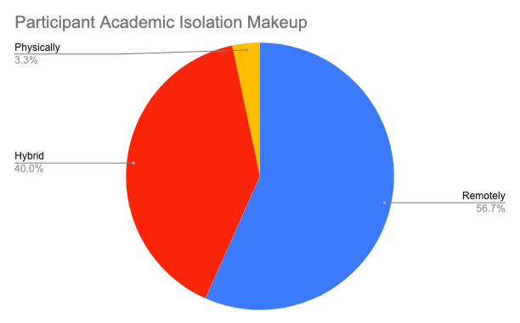
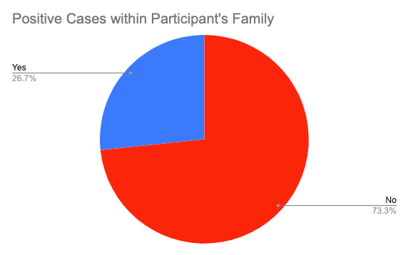
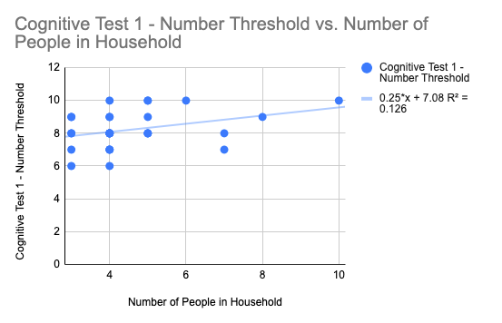
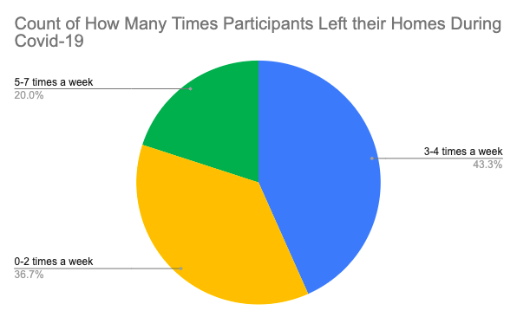
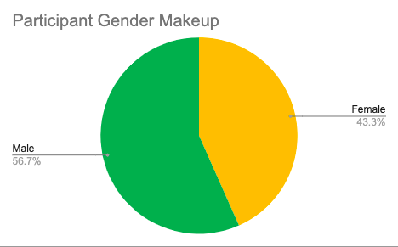
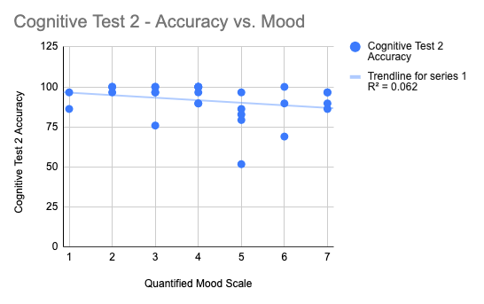
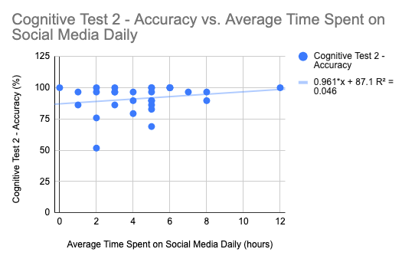
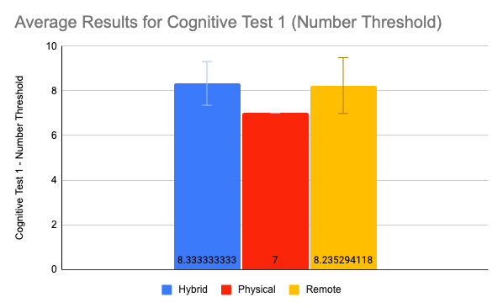
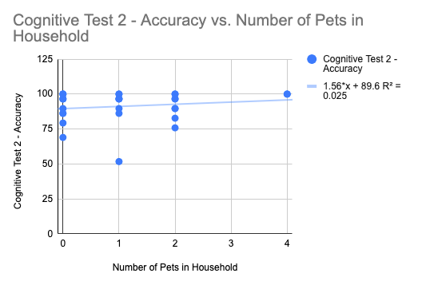
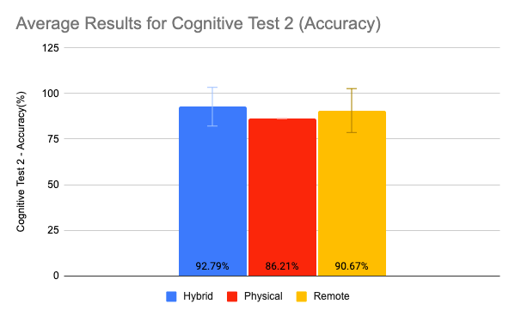
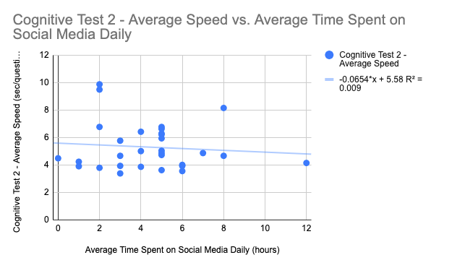
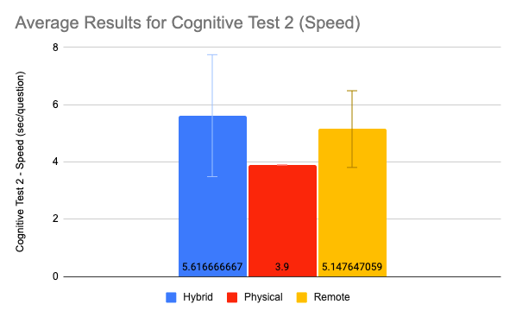
A Study of the Cognitive Effects on Students as a Result of Social Isolation During COVID-19
Katarina Rae Ladaga, Emma Sarro, PhD
Science Department, Dominican College
Orangeburg, NY, 10961
KatarinaRae.Ladaga1@dc.edu
Abstract
Results
Results
Conclusion
At the beginning of spring, 2020, we were faced with a global pandemic that forced us to both socially isolate and socially distance ourselves. However, this form of isolation has proven to be unlike any other. In addition to the well-known difficulties that come with separating oneself from friends, family, and society, there is yet another layer that harms our health. This pandemic has added a great sense of fear, guilt, and pressure, which likely puts a strain on all aspects of our well-being; physically, emotionally, and cognitively (Pietrabissa and Simpson, 2020). While this is not the first pathogen pandemic this country has faced, there are a multitude of social media platforms and other newer technologies that allow for many different forms of communication, and easier access to virtual forms of social interaction.
Therefore, we were interested in studying the emotional and cognitive effects of social distancing and isolation that occurred following the Covid-19 outbreak and make comparisons to what has been previously reported (Hawley and Capitano, 2015). We used surveys to determine the levels of social isolation and the forms of virtual access each subject had access to. Each subject then participated in the Digit Span Test and the Paced Auditory Serial Addition Test. This allowed us to determine whether cognitive results were predicted by levels of social isolation.
General Demographics of Participants
Figure 3a. Does the number of family members in the home predict working memory?
A Linear Regression Model of Number Threshold vs. Number of People in household. A Pearson correlation coefficient of .35 proved to indicate a low correlation.
Average test results from each level of academic social isolation (Figures 2a-c) suggest that working memory and informational processing of those who have been more academically social (Hybrid) is slightly better than those who have been in isolation (Remote).
In addition, those attending school in a form of a hybrid manner also had a higher number of family members living in their household.
Therefore, they were more socially stimulated than the other two groups regarding physical interaction.
Future studies will focus on obtaining subjects who were solely on campus (Physical) to improve this comparison.
Correlations conducted within this study did not suggest a strong prediction between non-academic social aspects of isolation and cognitive performance, however more subjects would be needed in future work.
This study will serve as a steppingstone for further research that will be done to solidify the results presented here.
Figure 1a. Participant Academic Isolation Makeup
Figure 1b. Covid Cases Within Family members
Figure 3b. Does the participant’s mood predict informational processing accuracy? (1 being the best & 10 being the worst)
A Linear Regression Model of Accuracy vs. Quantified Mood Scale. A Pearson correlation coefficient of -.25 proved to indicate a weak correlation.
Figure 1c. # of Times Participants Left their Homes
Figure 1d. Participant Gender Makeup
Figure 1. Several ways in which survey results were recategorized. These groupings, along with others were tested against the cognitive scores. Note: Majority of the participants attended classes remotely while leaving their homes a minimal amount of 3-5 times a week. In addition, most of their family members were not diagnosed with Covid-19.
Figure 3c. Does daily social media usage predict informational processing accuracy?
A Linear Regression Model of Accuracy vs. Average Time Spent on Social Media. A Pearson correlation coefficient of .21 proved to indicate a weak correlation.
Methodology
Average Test Results for Each Level of Academic Isolation
Working memory was assessed in Cognitive task 1. Hybrid students had an average of 8.33 +/-0.98 st.dev. The single physical student scored 7 digits, which was counted as the average. Remote students had an average of 8.24 +/- 1.25 st.dev. The Hybrid group proved to have a slightly higher measure of working memory.
Subjects:
A total of 30 subjects were recruited from the student population at Dominican College as well as through the Principal Investigator’s own social network, between the ages of 18-24.
Behavioral assessment:
Survey: All subjects met using the Zoom application. Participants were first asked to complete an anonymous online survey to evaluate their general demographic, level of isolation and virtual access, and if there were any noticeable changes in physical, mental health, and cognition.
Cognitive tests: The first test, the Digit Span Test, measures their working memory. Two sets of randomly generated numbers for different number of digits were held up to the camera one by one, to which they had to recall the order of number presentation. Their working memory threshold was determined as the highest number recalled without a mistake. The second test, the Paced Auditory Serial Addition Test (PASAT), measures their informational processing by calculating an accuracy percentage as well as an average speed score. A list of numbers was verbally relayed to which the participant had to type in the sum of the previous two numbers in the series without getting them confused to those said prior.
Analysis:
Variances between the three academic levels of isolation were analyzed with an ANOVA test to determine if there were any statistically significant differences between the means. In addition, the survey responses allowed for multiple variables to test. Thus, linear regressions were computed to determine if a correlation existed between the different variables and cognitive performance.
Figure 3d. Does number of pets in the home predict informational processing accuracy?
A Linear Regression Model of Accuracy vs. Number of Pets in Household. A Pearson correlation coefficient of .16 proved to indicate a very weak correlation.
Figure 2a. Number Threshold vs. Level of Isolation
Informational processing accuracy was assessed in the PASAT test. Hybrid students scored an average of 92.7% +/- 10.62 st.dev. The single physical student scored an accuracy of 86.21%, which was the counted as the average. Remote students scored an average of 90.67% +/-12.05 st.dev. The Hybrid group demonstrated slightly higher informational processing accuracy.
Figure 3e. Does the participant’s mood predict informational processing speed?
A Linear Regression Model of Speed vs. Time Spent on Social Media Daily. A Pearson correlation coefficient of -.10 proved to indicate a very weak correlation.
Figure 2b. Accuracy vs. Level of Isolation
References
Informational processing speed was assessed in the PASAT test. Hybrid students took an average of 5.62 sec +/- 2.13 st.dev. The single physical student took 3.90 seconds, which was counted as the average. Remote students took an average of 5.15 sec. +/-1.34 st.dev. The Remote group showed slightly higher informational processing speed.
***Correlations for threshold, speed, and accuracy were calculated against each independent variable above. Results indicate that some survey measures slightly predict cognitive performance.
Hawkley, Louise C., and John P. Capitanio. "Perceived Social Isolation, Evolutionary Fitness And Health Outcomes: A Lifespan Approach". Philosophical Transactions Of The Royal Society B: Biological Sciences, vol 370, no. 1669, 2015, p. 20140114. The Royal Society, doi:10.1098/rstb.2014.0114. Accessed 4 Oct 2020.
Pietrabissa, Giada, and Susan G. Simpson. "Psychological Consequences Of Social Isolation During COVID-19 Outbreak". Frontiers In Psychology, vol 11, 2020. Frontiers Media SA, doi:10.3389/fpsyg.2020.02201. Accessed 4 Oct 2020.
_________________________________________________________
Other Findings:
Survey questions also investigated the impacts of social distancing on sleep and eating habits, as well as overall mental and physical health.
These results indicate participants’ experience of inconsistent sleep patterns, less frequent and unhealthy eating, in addition to a decrease in mood.
Figure 2c. Speed vs. Level of Isolation
***ANOVAs for each figure were tested and deemed the data to be not significantly different at a 95% confidence interval.

