Slide 1
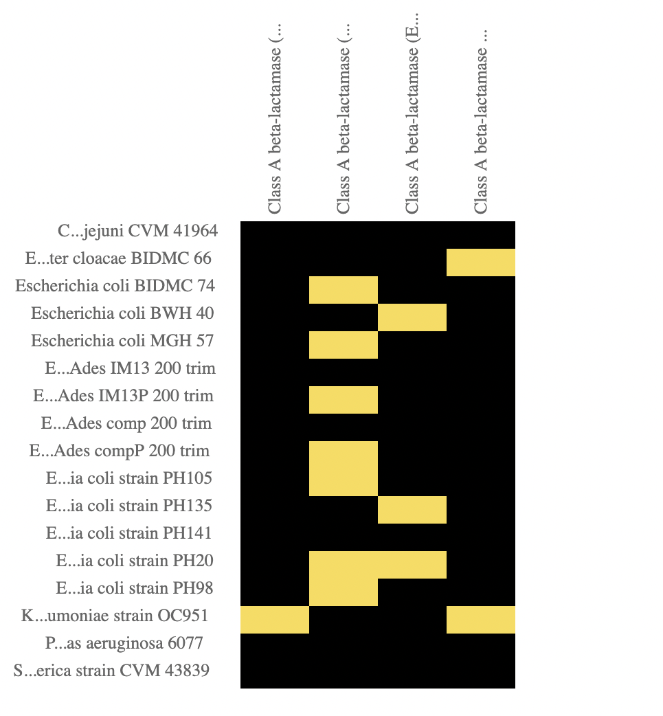
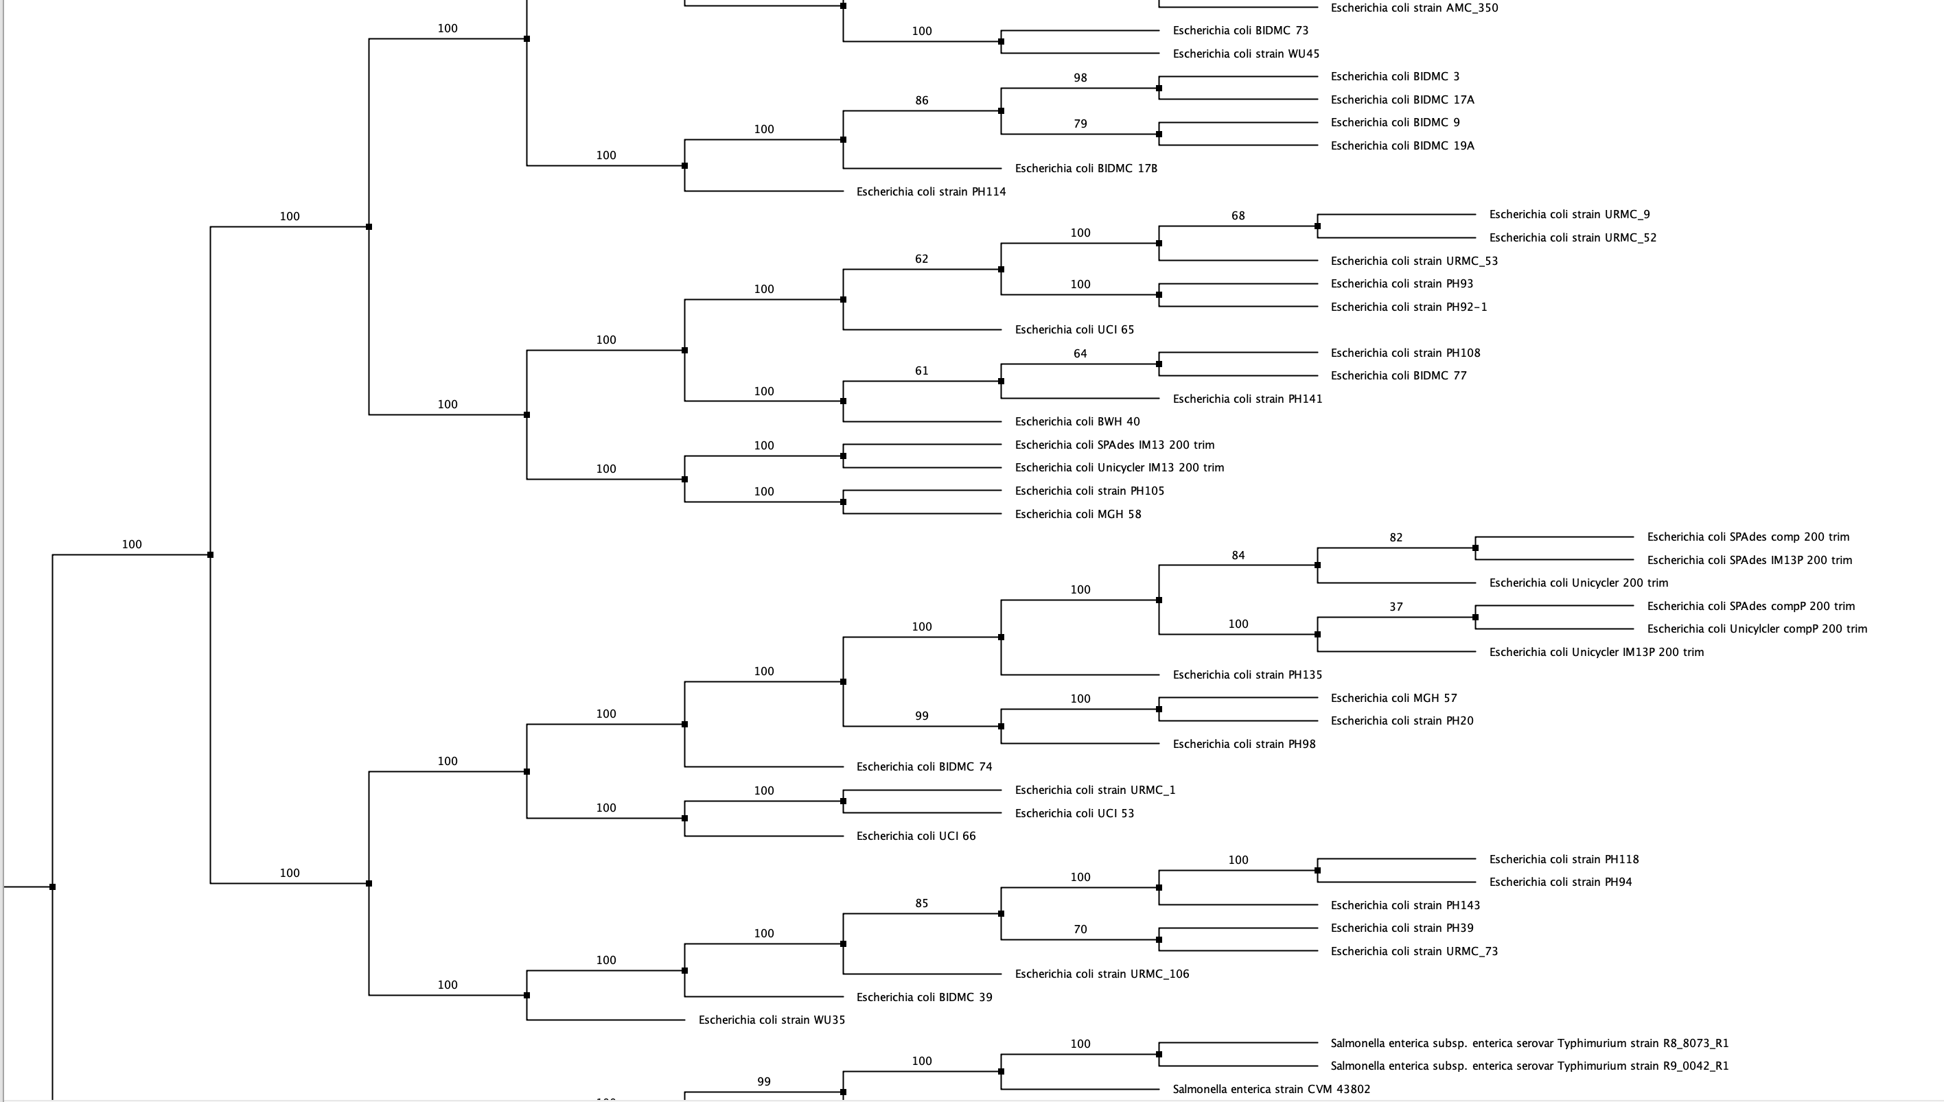
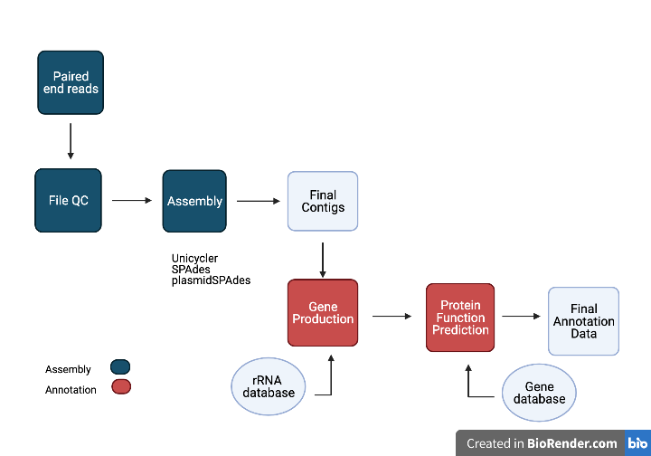
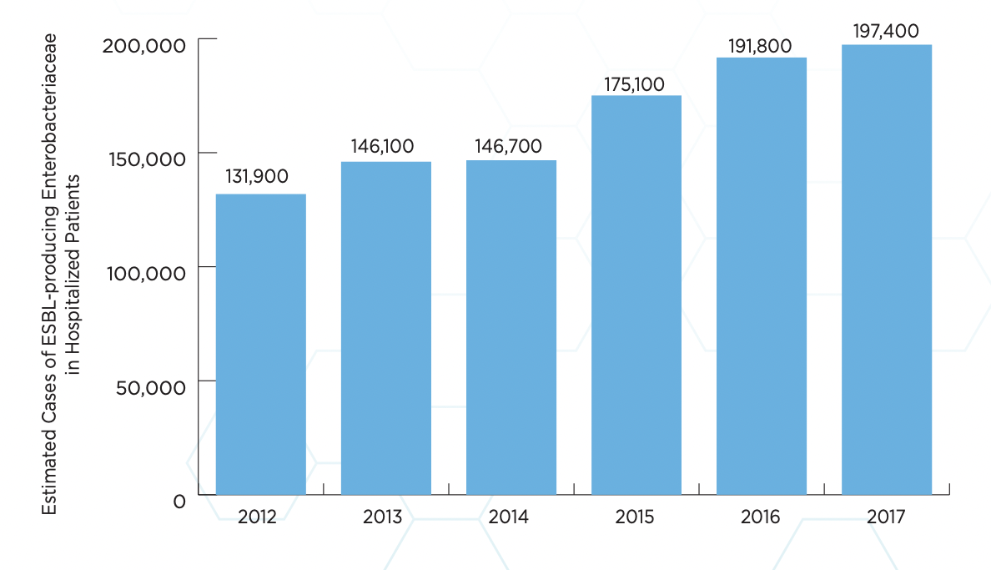
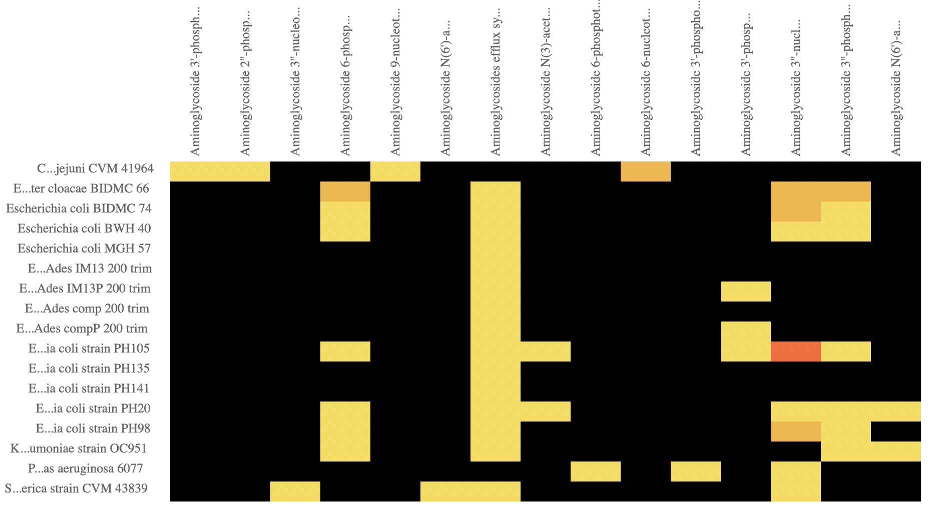
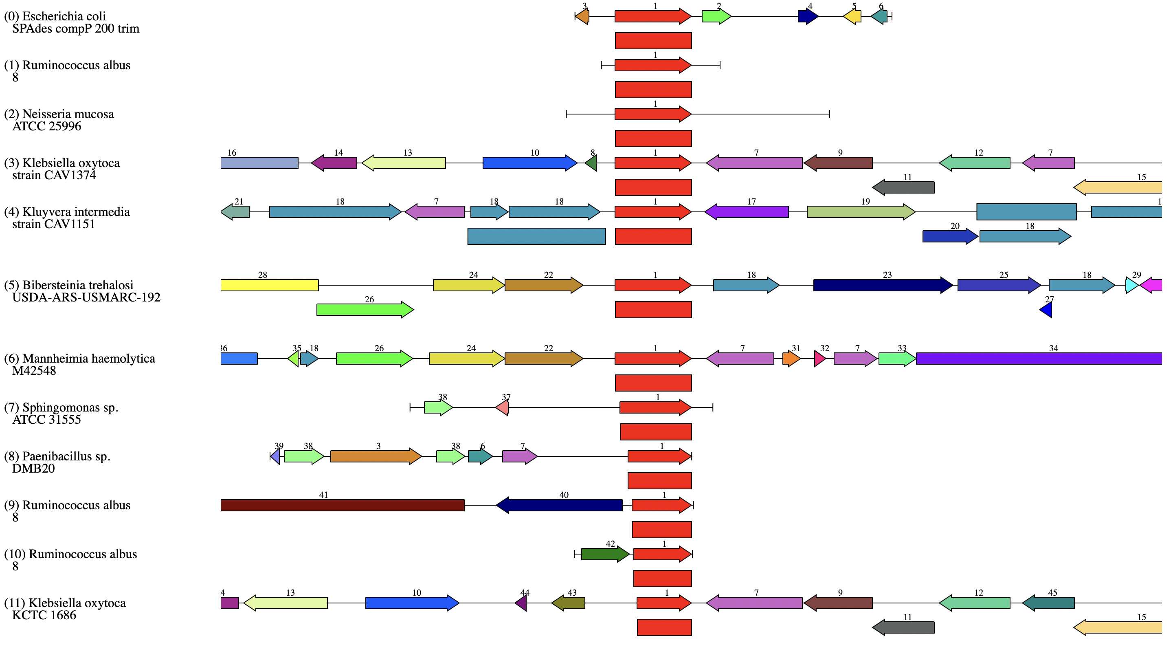
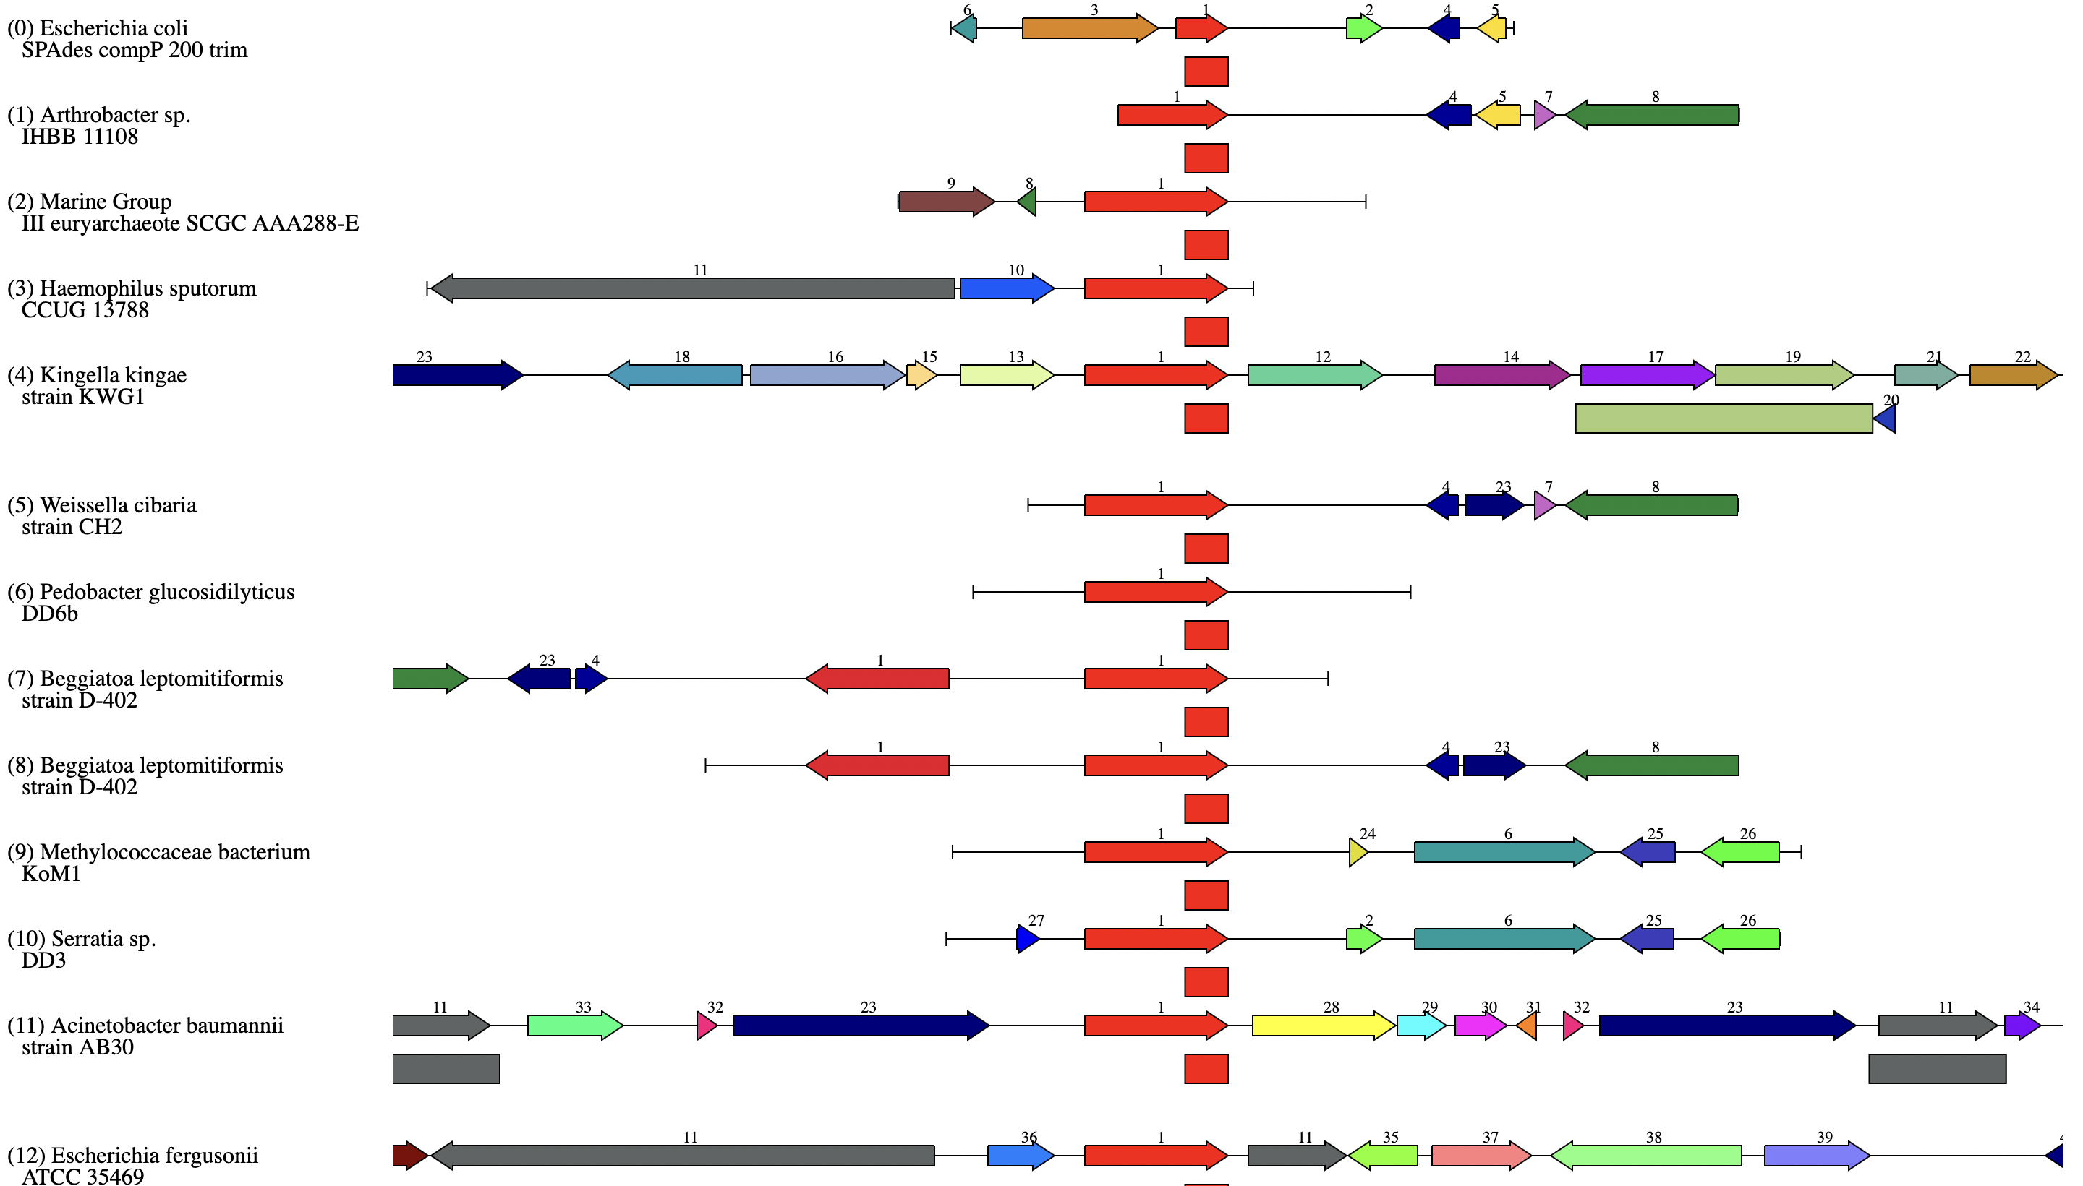
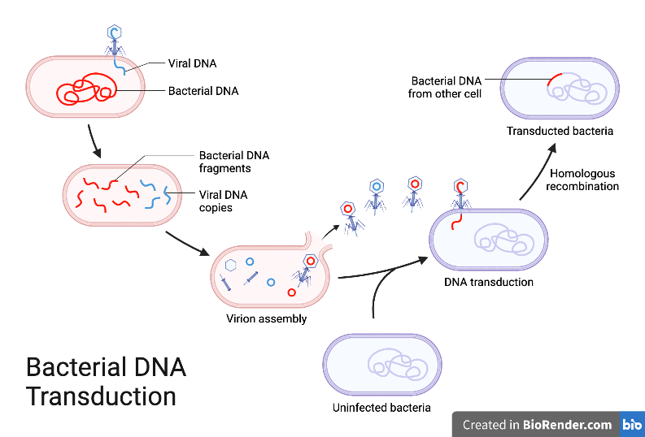
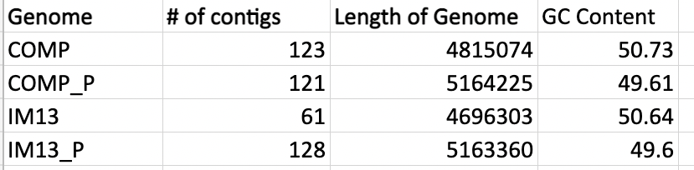
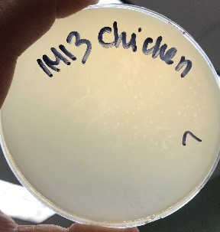
Discovery of Antibiotic Resistance Genes Transferred Between Bacteriophage and Bacteria
Jasmine Pesante, Emma Sarro PhD, Bernadette Connors PhD
Science Department, Dominican College
Orangeburg, NY, 10961
Jasmine.Pesante1@dc.edu
Abstract
Goal/Hypothesis
Results
Increased use of antibiotics has triggered a rise in multidrug resistant bacteria. Infections caused by multidrug resistant gram-negative bacteria (i.e. Escherichia coli) has been a continuous a problem for healthcare. One proposed solution is to use bacteriophage, a virus that infects and kills bacteria, to combat these infections. (Taati, 2020) However, bacteriophages may also transfer genetic material from one bacterial cell to another. Effects of this genetic transfer through transduction could have negative consequences, as these phage could facilitate the transfer of antibiotic resistance genes between bacterial cells. (Muniesa, 2004) Preliminary research from our lab showed that one strain of E. coli (Comp) when infected with phage had increased susceptibility to antibiotics, while another infected strain of E. coli (IM13) had increased resistance. The goal of this research was to understand how the genomes were altered as a result of phage infection with regard to antibiotic resistance elements. Using PATRIC, a bioinformatics program, genomes were assembled and annotated with Unicycler and SPAdes, after which antimicrobial resistance factors were explored. The host bacteria infected with prophage were found to have two additional antibiotic resistance genes. One of these, Class A beta-lactamase, provides bacteria resistance to antibiotics that contain a beta-lactam ring, like penicillin (Bush, 2016). The other, which encodes Aminoglycoside phosphotransferase provides bacteria with resistance against antibiotics, like streptomycin (Ramirez, 2010). These results could have implications against bacteriophage use as prophage, as they might facilitate the transfer of antibiotic resistant genes to a normal microbiome.
The goal of this research is to examine the differences in the host genome and the host infected with phage
Hypothesis: Phage are able to transfer antibiotic resistance genes to bacterial host through horizontal gene transfer
Procedure
Background
Over time, bacteria have developed resistance factors to combat antibiotic mechanisms. Extended beta-lactamase producing enterobacteria, such as Escherichia coli have developed these resistance factors in the form of a beta-lactamase enzyme or aminoglycoside phosphotransferases, which targets the effect of antibiotics.
Figure 12: Heat map of E.coli strains and beta lactamase genes
Figure 14: Phylogenetic tree of E.coli strains with other gram-negative bacteria.
E.coli infected with phage had Class A beta-lactamase gene and Aminoglycoside phosphotransferase gene
Aminoglycoside phosphotransferase gene and Class A Beta-lactamase gene were transferred together
Phylogenetic Tree showed IM13 and competent strains cluster around other strains of Escherichia coli.
Figure 1: Cases of infection with extended beta-lactamase producing bacteria between 2012-2017 (CDC)
Figure 6:Methodology used to assemble and annotate genomes
Figure 13: Heat map of E.coli strains and aminoglycoside genes
Phage therapy is a suggested solution to antibiotic resistance, as bacteriophages are able to infect specific bacteria. These phage transfer genetic material from on cell to the next.
Prior results showed increased susceptibility to antibiotics for the competent strain of E.coli and increased resistance for the IM13 strain.
Results
Assembly
Unicycler assembles both long and short read
SPAdes assembles just short reads
plasmidSPAdes assembles plasmids
Both Unicycler and SPAdes produced very similar assembly and annotation outputs
Figure 7: Table of assembly output
Figure 15: Region viewer of aminoglycoside gene
Figure 16: Region viewer of class A beta-lactamase gene
Figure 2: Process of bacterial transduction illustration
Annotation
Strains Used
Unicycler and SPAdes use to to create annotation
Annotation assigned protein families and showed the host infected with phage had two extra genes for antibiotic resistance.
Summary/ Conclusions
Specialty Genes | # of Genes
Virulence Factors | 235
Transporter | 891
Drug Target | 387
Antibiotic Resistance | 75
Strain | Annotation | # with function | # without function | % features in local protein families
E. coli comp | Unicycler200 | 3528 | 1220 | 97.09
 | SPAdes200 | 3534 | 1225 | 97.42
E. coli comp-phage | Unicycler200 | 3559 | 1804 | 95.13
 | SPAdes200 | 3570 | 1816 | 95.14
E. coli IM13 | Unicycler200 | 3341 | 1078 | 98.21
 | SPAdes200 | 3573 | 1097 | 98.09
E. coli IM13-phage | Unicycler200 | 3553 | 1801 | 95.18
 | SPAdes200 | 3344 | 1811 | 95.04
Host bacteria infected with phage found to have two additional antibiotic resistance genes
Class A Beta-lactamase: inhibits the effects of common antibiotics (Penicillin and Cephalosporins)
Aminoglycoside phosphotransferase: inhibits the effects of aminoglycoside antibiotics (Streptomycin and Gentamicin)
This could have implications that question the efficacy of phage therapy as the phage may transfer antibiotic resistance to the normal biome
zone of inhibition (mm)
Figure 8: E.coli comp annotation genes
Figure 3: Plaques of phage infected E.coli
Figure 4: E.coli strains zones of inhibition with different antibiotics
Specialty Genes | # of Genes
Virulence Factors | 237
Transporter | 888
Drug Target | 391
Antibiotic Resistance | 77
Figure 10: E.coli strains annotations with functional and nonfunctional proteins
Acknowledgements
Phage sample collected from chicken and dog fecal matter
Phage isolated and allowed to infect both competent and IM13 E.coli strains
Plaques examined to determine phage activity in different strains
Genomic Feature
CDS | 4748
tRNA | 80
Crispr_repeat | 30
Crispr_spacer | 28
Crispr_array | 2
rRNA | 2
I would like to thank the Science Department at Dominican College for funding this study, as well as Dr. Bernadette Connors and Dr. Emma Sarro for their mentorship. I also thank Siobhan O’Sullivan for laboratory assistance.
Figure 9: E.coli comp with phage annotation genes
References
Davis JJ et al. The PATRIC Bioinformatics Resource Center: expanding data and analysis capabilities. Nucleic Acids Res. 2020 Jan 8;48(D1):D606-D612.
Figure 5: Growth curve for E.coli strains
Annie Segura and Kayla Johnson (2020)
Figure 11: Genomic features of E.coli strains
ESBL-producing Enterobacterales. (2019, November 22, https://www.cdc.gov/hai/organisms/ESBL.html

