Slide 1
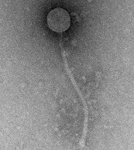
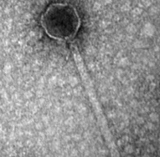
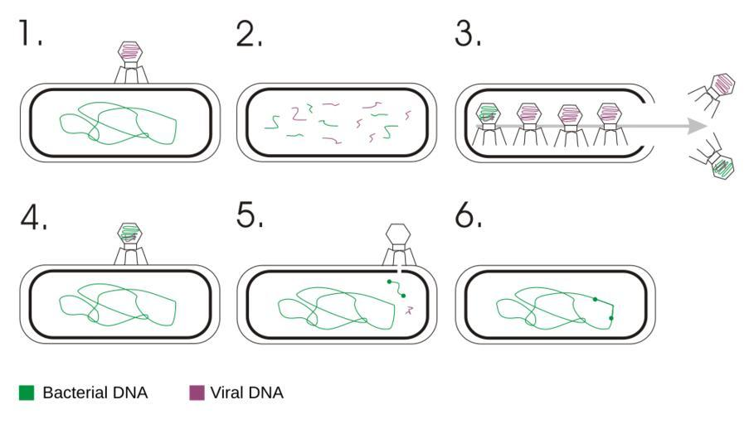
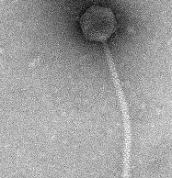
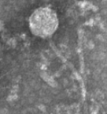
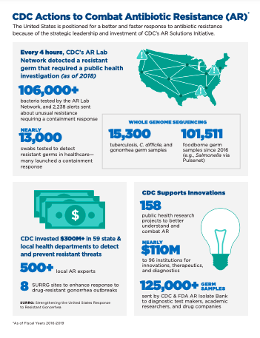
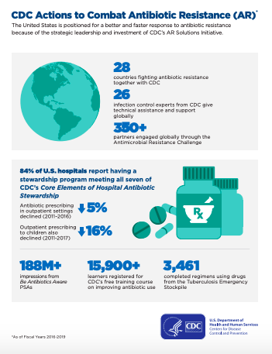
Horizontal Gene Transfer in Mycobacterium
Tema Frees
Mentors: Dr. Bernadette Connors* and Dr. Regina Alvarez*
Dominican College, 470 Western Highway, Orangeburg, NY 10962
*Corresponding author: bernadette.connors@dc.edu, regina.alvarez@dc.edu
ABSTRACT
PHAGES
RESULTS
Horizontal gene transfer occurs when the DNA of two different organisms is shared. These organisms may then develop functions that they initially did not have, such as antibiotic resistance. The purpose of this study is to determine if horizontal gene transfer has occurred between Mycobacterium smegmatis and their bacteriophages. Using BLASTP searches, the proteins of five bacteriophages, Apex, EleanorGeorge, Joselito, Miniwave, and Spikelee, were compared against proteins of Mycobacterium smegmatis. In order to do this, accession numbers from each phage protein were searched against M. smegmatis (taxid:1772). The positive proteins are then compared against each other. These results would determine whether or not horizontal gene transfer occurred.
Phage Name | Cluster Identity | Genome Length (bp) | Number of Proteins Run | % of Probable HGT
Apex | B, B4 | 71244 | 7 | 85.7%
EleanorGeorge | F, F1 | 59482 | 12 | 83.3%
Joselito | A, A11 | 52347 | 15 | 100%
Miniwave | E | 74961 | 15 | 86.6%
Spikelee | F, F1 | 58604 | 13 | 84.6%
Query ID: The query ID is the accession number of each protein run.
Scientific Name: This is the name that a bacteria can be identified by.
Query Cover Percentage: This aligned segments percentage. Percentages over 70% are considered relevant, but the closer the number is to 100%, the more pertinent the data is.
E-Value: This is the expected value. The closer the e-value is to zero, the more likely there is horizontal gene transfer present.
Figure 6. Example data from selected phage proteins.
Figure 5. Types of data collected
BACKGROUND
Figure 7. BLASTP Alignment Data. Miniwave, Accession Number :QOI67786.1; Right: Forward; Left: Reverse
Horizonal gene transfer by transduction allows for two organisms to develop characteristics they would not necessarily have on their own.
Apex
EleanorGeorge
Spikelee
Figure 1. Horizontal Gene Transfer Between Bacteria and Phage
(Image courtesy of commons.wikimedia.org)
Figure 3. Electron micrographs of selected phage.
Joselito
Miniwave
CONCLUSIONS & FUTURE STUDIES
There is some evidence that points toward horizontal gene transfer between mycobacteriophage and M. smegmatis.
There are not enough data in this study to consider anything done significant.
In order for this research to be successful, future studies would need to include a wider range of bacteriophage.
Analysis of different phenotypes that bacteria develop when horizontal gene transfer occurs.
One characteristic of concern is the development of antibiotic resistance in bacteria.
METHODOLOGY
Click on the accession number found on the phage's page (on phagesdb.org). This will take you directly to NCBI page for that phage.
On the NCBI page, on the right side of the page, find the section titled "Related Information" and click on "Protein". This will take you to the proteins for that phage (well, protein-encoding genes).
To download the accession numbers, click on "Send To", found at top of the page. Click then on "File" in dropdown menu, and choose "Accession List" in "Format" dropdown menu.
Once all accession numbers are accessed, go to NCBI BLASTP, paste a list of accession numbers into the text box, and set the organism to “Mycobacterium smegmatis”.
The file will have a .seq extension. You can, however, open it in a text editor simply by choosing to "Open With" and choosing the text editor you have on your computer.
A list of results will come back. Some of the accession numbers will have an “*” next to it. This means that there was no significant data linked to that specific protein,
Make list of all the proteins with no “*”. With that list, go to GoogleColab to begin getting reverse proteins.
Figure 4. Methodology
REFERENCES
Snustad, D. P., & Simmons, M. J. (2012). Principles of genetics. Singapore: John Wiley & Sons
The Actinobacteriophage Database: Phage Apex. (n.d.). Retrieved from https://phagesdb.org/phages/Apex/
The Actinobacteriophage Database: Phage EleanorGeorge. (n.d.). Retrieved from https://phagesdb.org/phages/EleanorGeorge/
The Actinobacteriophage Database: Phage Joselito. (n.d.). Retrieved from https://phagesdb.org/phages/Joselito/
The Actinobacteriophage Database: Phage Miniwave. (n.d.). Retrieved from https://phagesdb.org/phages/Miniwave/
The Actinobacteriophage Database: Phage Spikelee. (n.d.). Retrieved from https://phagesdb.org/phages/Spikelee/
(n.d.). Retrieved from https://raw.githubusercontent.com/genomesolver/CSPpipeline/master/blast.py
What CDC is Doing: Antibiotic Resistance (AR) Solutions Initiative. (2020, October 28). Retrieved from https://www.cdc.gov/drugresistance/solutions-initiative/index.html
Figure 2. CDC Actions to Combat Antibiotic Resistance (AR)
OBJECTIVE
The purpose of this research is to determine if horizontal gene transfer occurs between bacteriophage and bacteria, specifically between Mycobacterium smegmatis and their phage.
In order to run batches of accession numbers, the python code can be used in a Google Colab notebook, three things are needed:
1: Accession numbers
(”input.txt”)
2: Folders: “output” and “tmp”
Code available at https://github.com/genomesolver/CSPpipeline
ACKNOWLEDGMENTS
I would like to thank the Science Department at Dominican College for funding this study, as well as Dr. Bernadette Connors and Dr. Regina Alvarez for their mentorship. We also thank Siobhan O’Sullivan for laboratory assistance.

