Slide 1
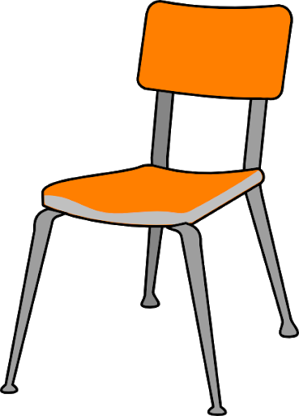
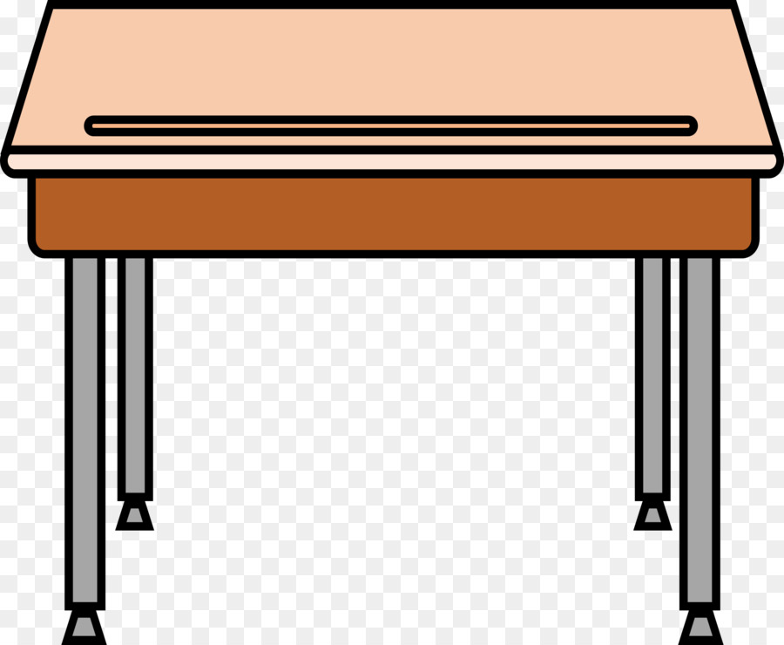
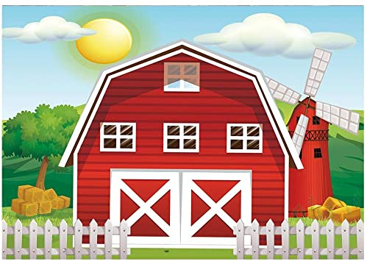
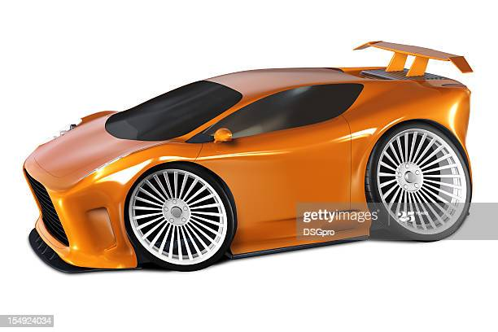
Impact of Exercise on Hippocampal-Based Learning in Children
Brittany Terrill, Dr. Emma Sarro
Science Department, Dominican College
Orangeburg, NY, 10961
Brittany.Terrill1@dc.edu
Rationale
Task images
Which type of image accounts for the change in performance after exercise?
Exercise is well-proven to improve human health, but recently is shown to also have a positive impact on brain structure and function, demonstrating a strong association between exercise and neurocognitive performance. A critical region of the brain supporting this relationship is the hippocampus, known for its involvement in the formation of new memories, such as object recognition and spatial memory.
Despite strong evidence for the benefits of exercise on cognitive function, very few studies have asked a similar question in children, a time of dramatic growth and development, specifically in cognitive function (Sorrells et al., 2018).
The primary aim of this research was to determine if physical activity integrated into a learning environment can impact cognitive performance of children, as has been shown in adults, specifically that which is hippocampal dependent.
Here: children, aged 5-9, were tested on a Mnemonic Similarity Task (Stark et al., 2019), which evaluates object recognition (a hippocampal dependent task). This was paired with either a brief period of exercise or a period of non-exercise-based activity. Their performance on a test of object recognition was then compared with a group of adults who underwent the same procedure.
Figure 1: Images used for the Initial encoding phase.
Figure 6: (right) After exercise children showed an improvement in recognition across all three types of images. The greatest improvement was found for the new (foils) and the similar (lures).
(below) After exercise, the adults showed improvement in recognition only in the similar (lures) images.
% CORRECT
Figure 2: Representative images used for the testing phase. Note: not all images are included here, and these include new, old and similar images. Also, images in the testing phase were presented one at at time in a predetermined randomized order.
Methods
% CORRECT
Subjects:
Children (ages 5-9) were randomly recruited and asked to volunteer. (Approval from their guardians will be obtained and the short experiment was explained prior to starting.) A control group of college- aged adults were also recruited and tested in the same way. As they are over 18 years of age and asked to volunteer personally.
Mnemonic Similarity Task:
This was adopted from previously published work by Stark et al., 2019. This is an object recognition task, in which a prior experience with a set of images is then tested against a second set of images which include some of the original, some new and some that are similar to the original.
During an initial "encoding" phase, all subjects were permitted to view a series of images (Figure 1). In order to encourage active viewing, the subjects were given a simple task of "categorizing" them. Following this, all subjects were asked to either participate in 5-10 minutes of fun physical activity (relay-races for the children or jogging up a set of stairs for the control group) or 5-10 minutes of video game/watching activity.
For the testing phase, each subject viewed a sequential sequence of images, all related to the original set of images in different ways. One third was identical to the original (called "targets"), one third was different (called "foils"), and the final third, (referred to as "lures”) was similar but not the same as the originals. Subjects are asked to decide whether each image was “old” (in the initial set), “new” (not in initial set), or “similar” (not the same object but a similar image to). Each response was recorded and plotted based on the type of image: target, foil or lure.
Analysis: Comparisons were made across intervention type (exercise or control) as well as age.
Children
Children demonstrate improvements in object recognition after a brief period of exercise, similar to adults.
Adults
Summary
Children who incorporated exercise in a learning environment displayed an average recognition performance of 76.36% on all images presented.
Children who played video games performed 14.73% lower on the same task.
College-aged adults who exercised performed at a rate of 75.58% on the recognition task.
Those who played video games performed 5.81% lower on the same task.
Differences in performance for children was primarily in recognizing “new” and “similar” images, whereas improvement adults was only in recognizing “similar” images. This suggests a difference in the hippocampal representation of these images, and the impact of exercise on this mechanism in the younger brain.
This study confirms that a short of period of exercise will impact cognitive performance in adults, and demonstrates that children also benefit cognitively to exercise in a learning environment.
Figure 3: The % correct in object recognition after a brief period of exercise (right) or video game playing in children. This includes all types of images. Standard error bars show variance.
Figure 4: The % correct in object recognition after a brief period of exercise (right) or video game playing in adults. This includes all types of images. Standard error bars show variance.
Figure 5: In comparison, children who exercised briefly showed a greater exercise-based improvement in object recognition than adults.
CHANGE IN AVG % CORRECT
CHILDREN
Sorrells, S., Paredes, M., Cebrian-Silla, A. et al. Human hippocampal neurogenesis drops sharply in children to undetectable levels in adults. Nature 555, 377–381 (2018). https://doi.org/10.1038/nature25975
Stark, Shauna M. Kirwan, C. Stark, Craig. ‘Mnemonic Similarity Task: A Tool for Assessing Hippocampal Integrity’. 6 Oct. 2019. https://doi.org/10.1016/j.tics.2019.08.003
ADULTS
Special thanks to Dr. Emma Sarro & the Science Department of Dominican College including Siobhan O’Sullivan and Veronica Glynn for all of their help. Thank you to my participants & parents for dedicating time to my research.

